Slide 1
Mobile App
Girl Scouts & Caregivers
Notes:
Script:
The next slides will cover using the Mobile App for Girl Scouts and Caregivers

Slide 2
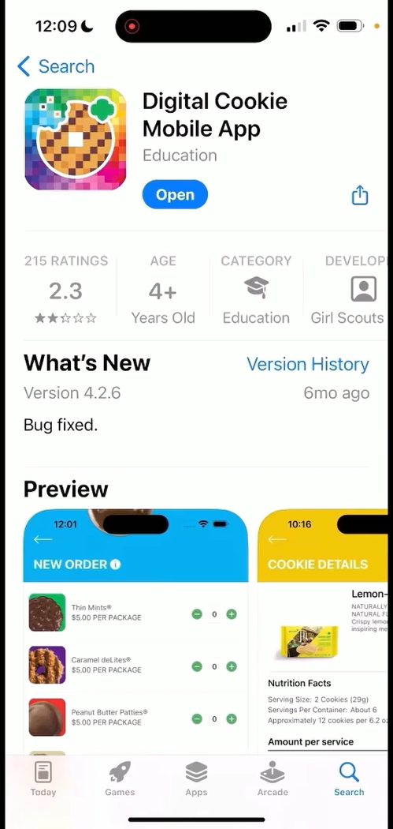
Digital Cookie Mobile App
Download a new version of the mobile app each year.
Mobile app found in iTunes or Google Play store.
Notes:
Script
Girl Scouts can use the Digital Cookie Mobile App to process and review orders placed through the Girl Scout’s individual site. Make sure to download a new version of the mobile app each year.

Slide 3
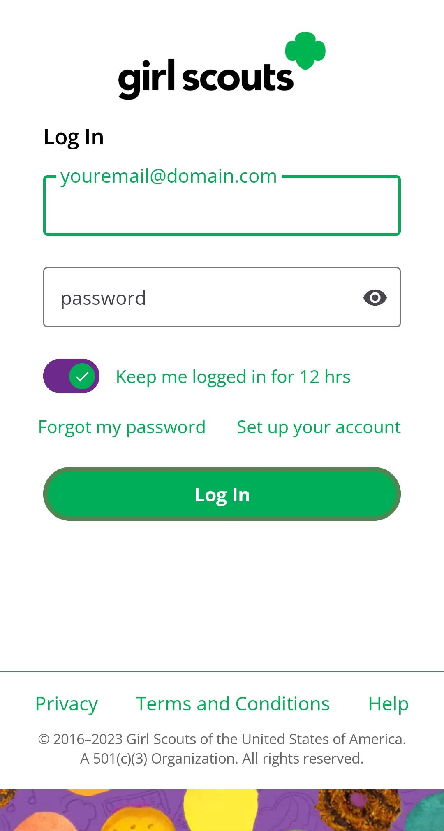
Logging In
Use the same email and password use for Digital Cookie
Girl Scout Cookie site must be published
Notes:
Script
To log into mobile app, you will use the same email and password used to log into the Digital Cookie browser site. The Girl Scout Cookie site must be published prior to accessing the mobile app.

Slide 4
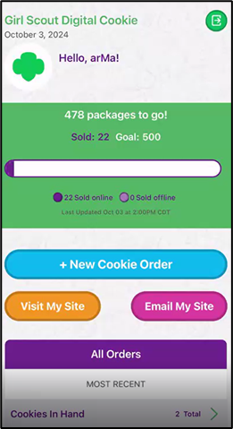
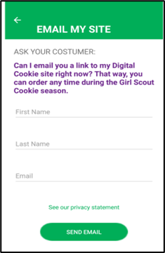
Digital Cookie Home Screen
Visit My Site
Customers can scan the QR code to visit the Troop’s Cookie Site.
Email My Site
Select Girl Scout’s Name
Girl Scout’s can send a marketing email to a customer.
Notes:
Script
When you first log into Digital Cookie, you might see multiple roles, this section of the training will cover your Girl Scout’s role. Select the role to be taken to her home screen. From here you can place a new cookie order, share the site with customers, or view all orders.
The “Visit My Site” button will take the Girl Scout to a QR code, the Girl Scout can then turn the phone around allow the customer to scan the QR code to make a purchase from the Troop’s Cookie Site.
The “Email My Site” button is used to send a marketing email to customers who can then purchase from the Troop’s Cookie Site at a later time.
To take an order using the mobile app, Girl Scouts will click the “New Cookie Order” button.

Slide 5
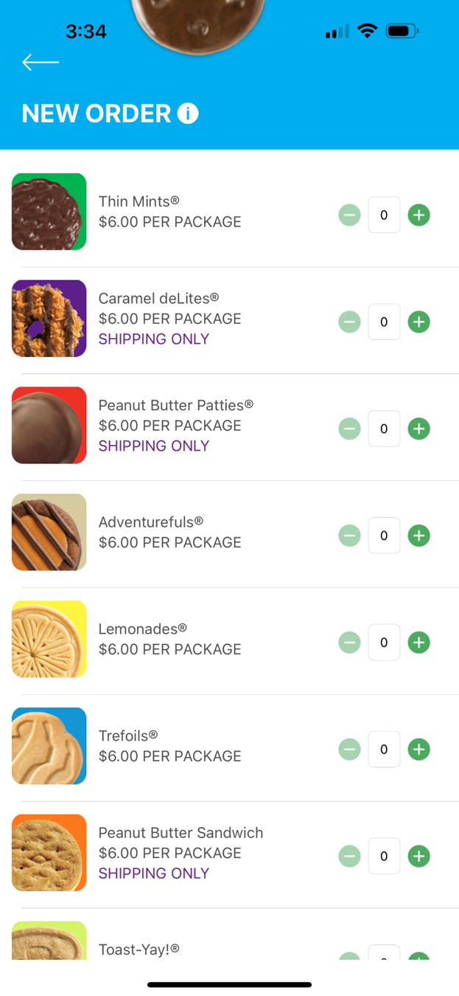
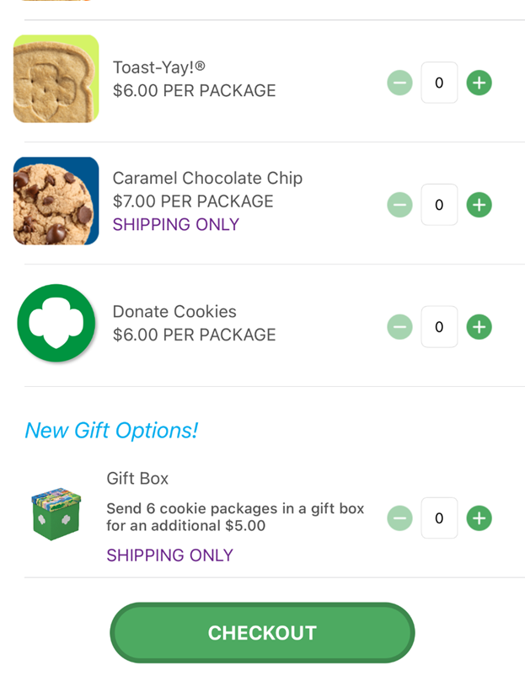
New Cookie Order
Notes:
Script:
To place a cookie order using the mobile app, the Girl Scout will select New Cookie Order, then enter the varieties the customer would like to purchase by using the plus and minus signs next to each cookie variety and click Checkout.

Slide 6
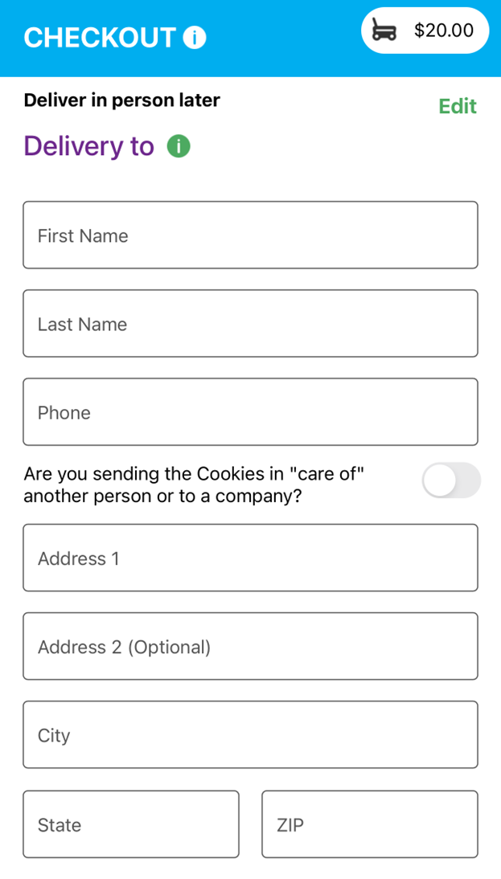
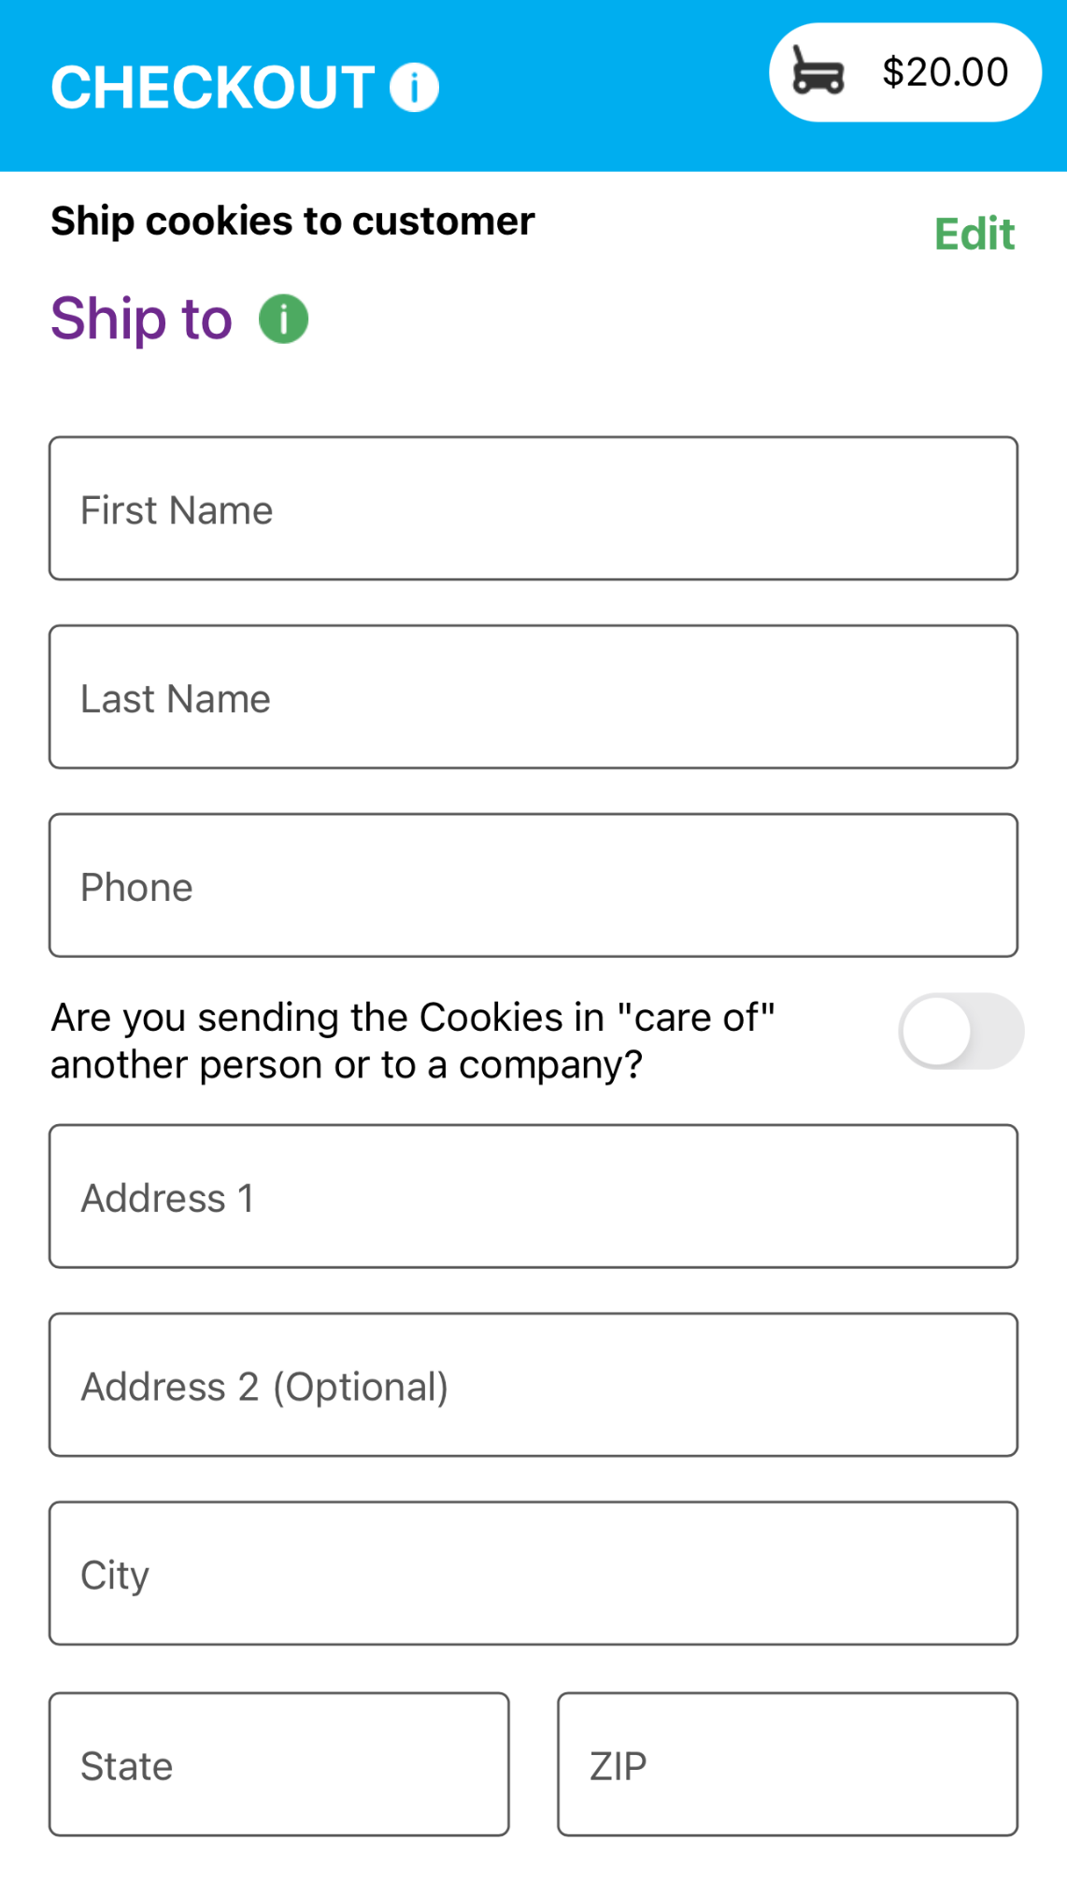
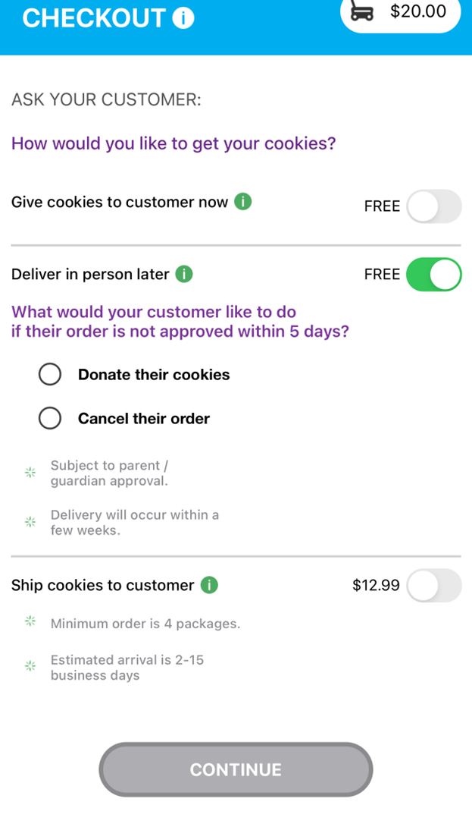
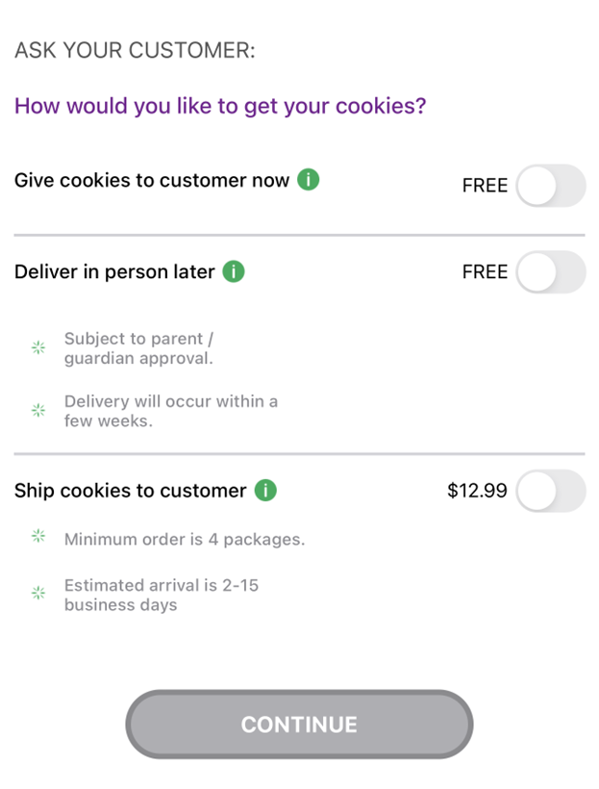
New Cookie Order
Deliver in person later
Ship cookies to customer
Step 2: Select how the customer would like to receive their cookies.
Notes:
Script:
Next the Girl Scout will select how the customer would like to get their cookies. We will cover the “Give cookies to customer’s now” option later in the training when we cover using the app at a cookie booth. If the Girl Scout, does not have the cookie varieties the customer would like or is taking pre-orders, she can select Deliver in person later, or if the customer would like to order cookies to ship to someone, she can select that option as well. It is recommended to use the QR code or “Email My Site” feature on the last screen for these to orders since it will require additional steps through the mobile app for the Girl Scout. If the Girl Scout selected “deliver in person later”, She will need to ask the customer if their order is not approved with in 5 days what would they like to do with their order. Then the Girl Scout will need to enter the customers delivery or shipped details. All before entering the customer’s payment information (which will be shown a little later).

Slide 7
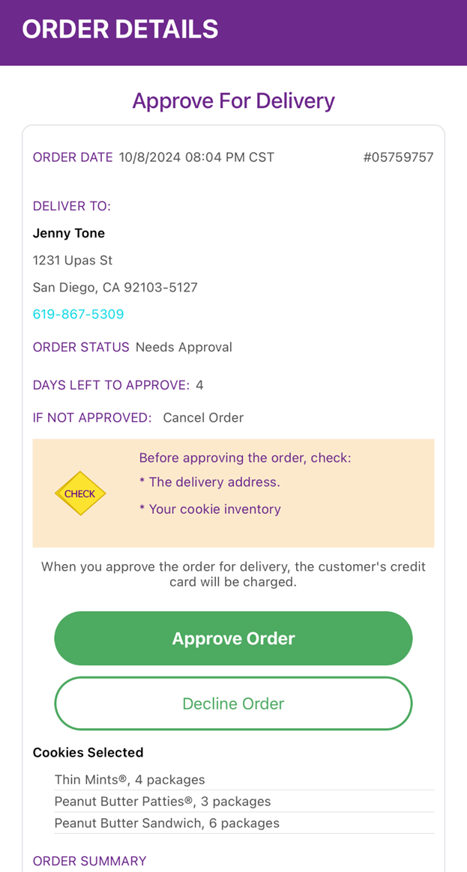
All orders for in-person delivery must be approved, even if placed through the mobile app
All Orders
Notes:
Script:
Once an order has been placed, the Girl Scout can view all orders (placed through the app and the Digital Cookie site) under the All Orders section from the home screen. To view the orders in a specific category, click on the green arrow to the right to bring up all the orders. Then click on the order you want to view. If the order is an in-person deliver order users can approve or decline the order from the app. If the Girl Scout has selected to Deliver in person later (as shown in the previous slide), she will still need to work with her caregiver to approve or decline the order.

Slide 8
Mobile App
Booths
Notes:
Script:
The next slides will cover the using the Mobile App when at a Cookie Booth

Slide 9
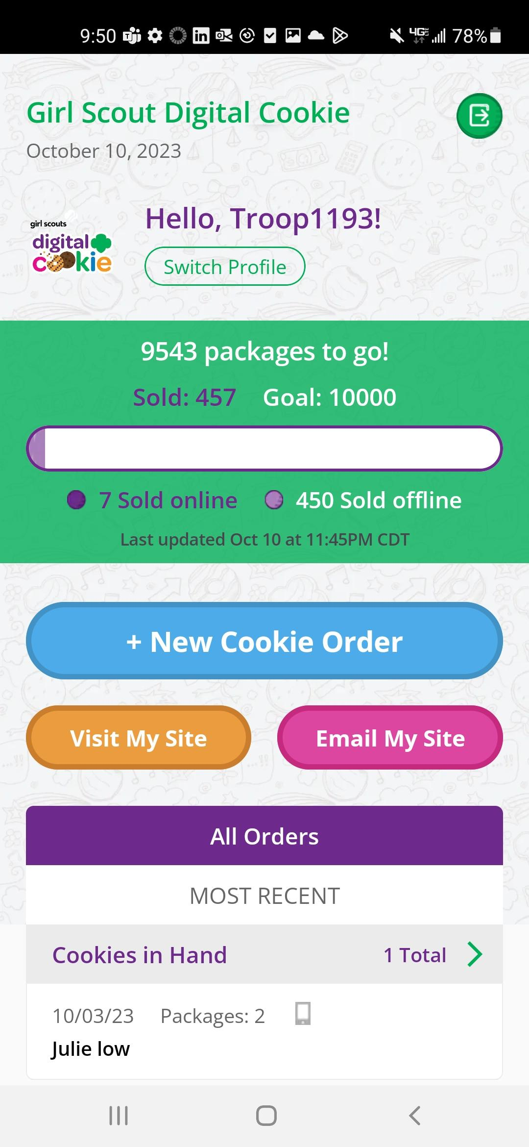
New Cookie Order
Placing an order at a cookie booth
Select the troop role
Notes:
Script
To take an order using the mobile app at a cookie booth, you will want to use the Troop Role, you can do this by selecting the troop role when you first log in or if you are already logged in under your Girl Scout’s account. You can select Switch Profile. To place an order, Girl Scouts will click the “New Cookie Order” button.

Slide 10
New Cookie Order
Step 1: Select Cookie Varieties
Notes:
Script:
First the Girl Scout will enter the varieties the customer would like to purchase by using the plus and minus signs next to each cookie variety. Then select Checkout.

Slide 11
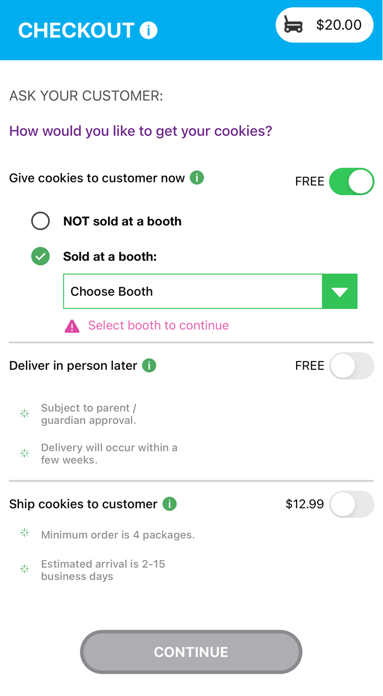
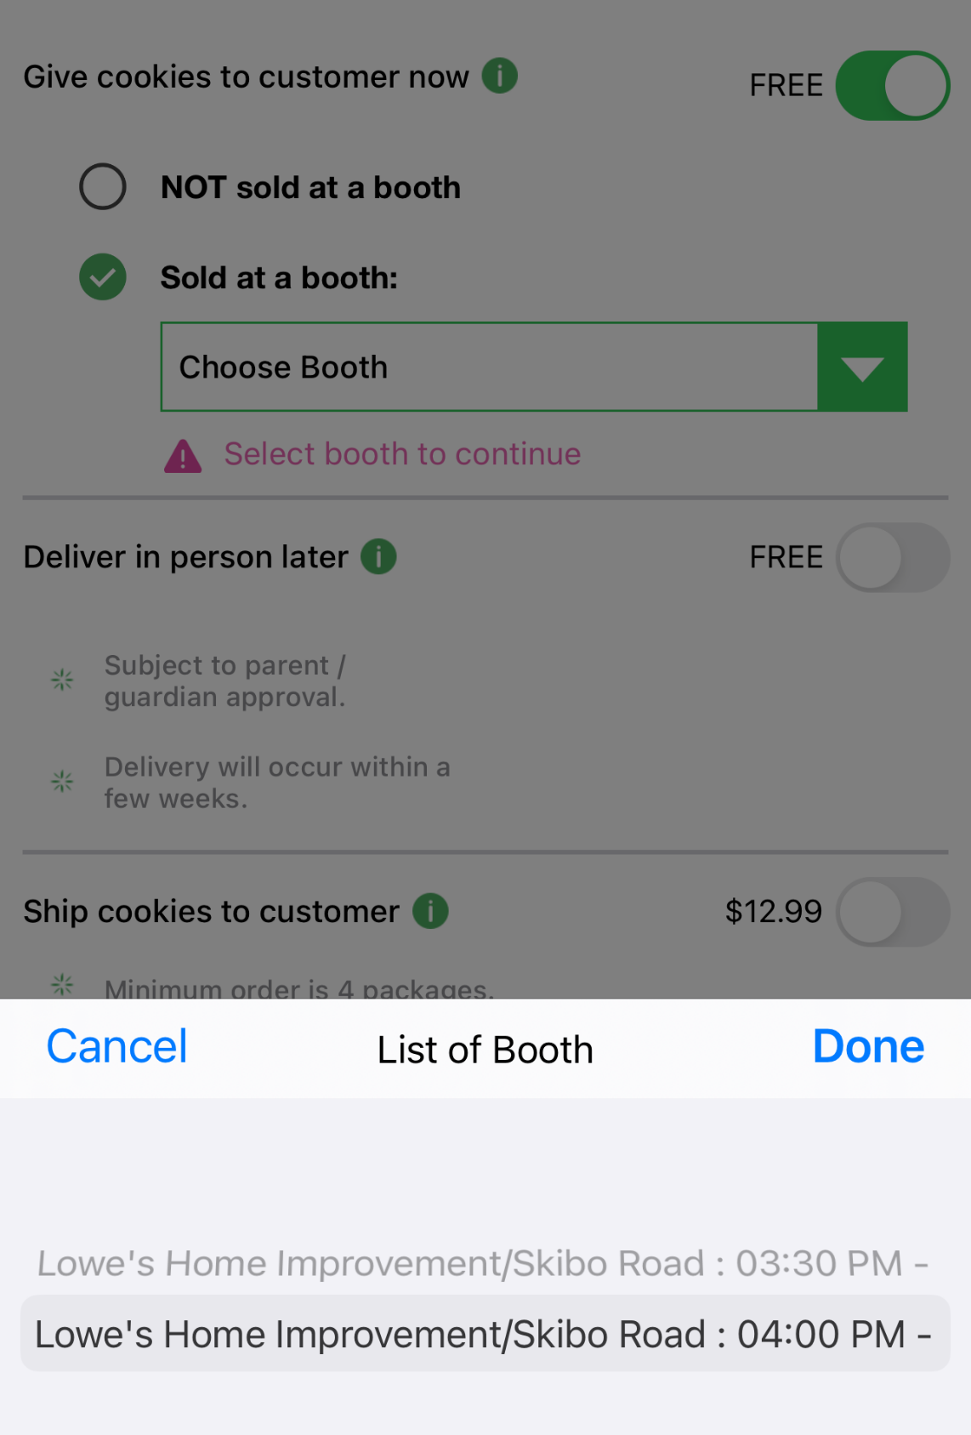
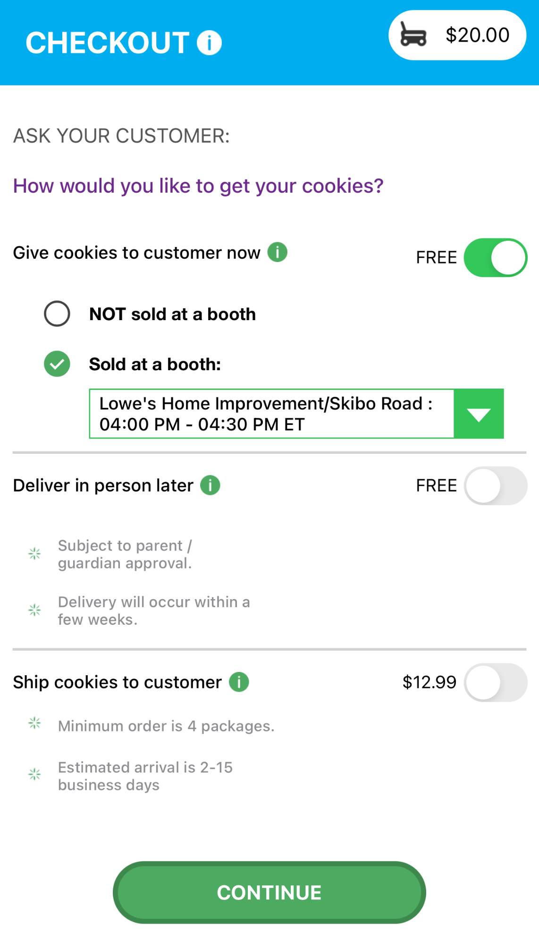
New Cookie Order
Step 2: Select how the customer would like to receive their cookies.
Notes:
Script:
Next the Girl Scout will select “Give cookies to customer’s now”, since she is at a cookie booth. Once the “Give cookies to customer now” option is select, the Girl Scout can now choose if she is at a booth or not. When the at a booth is selected, the Girl Scout will be able to select which booth the troop is at. Then click continue.

Slide 12
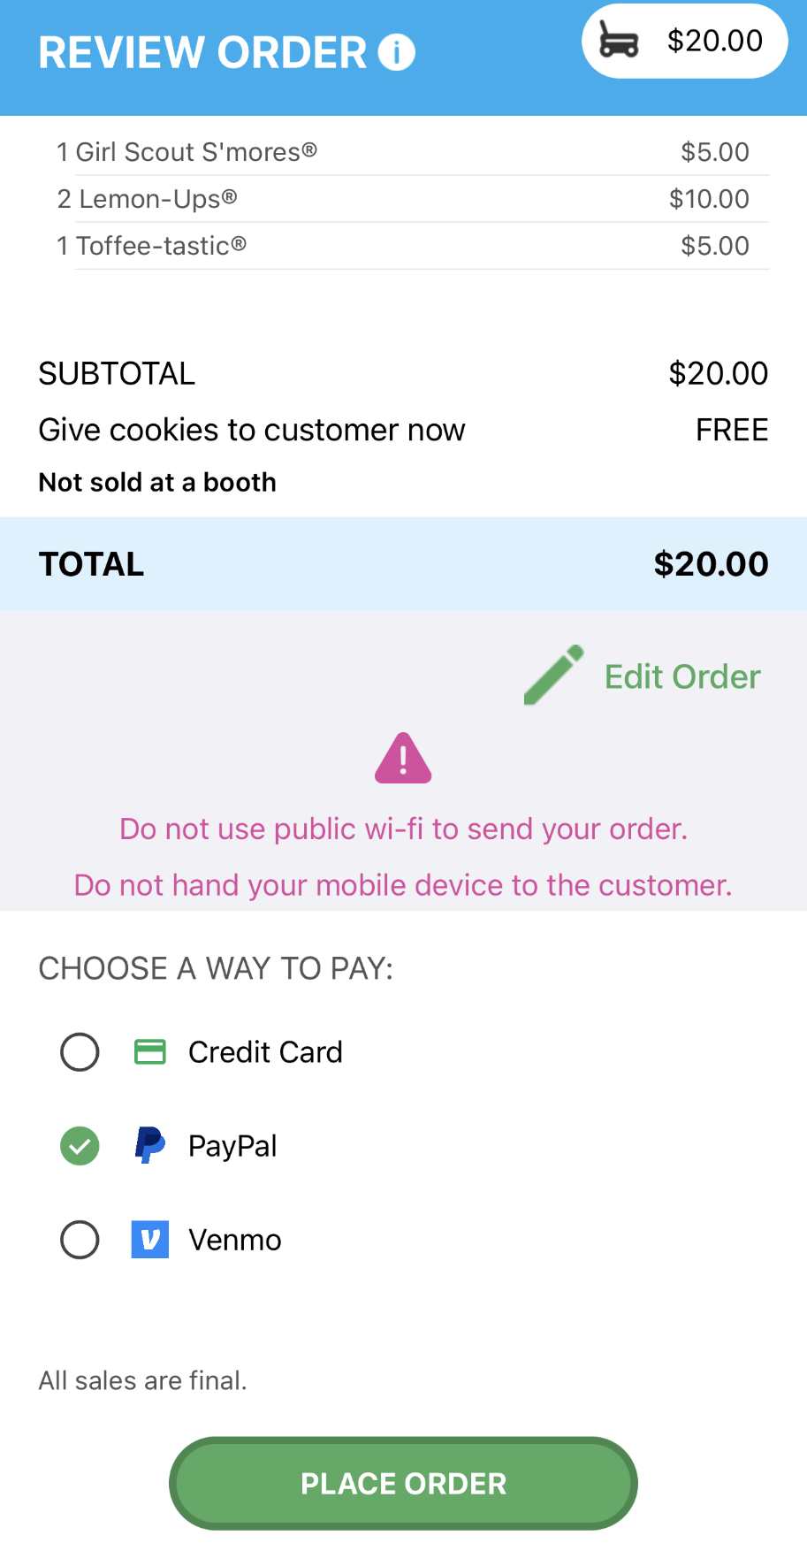
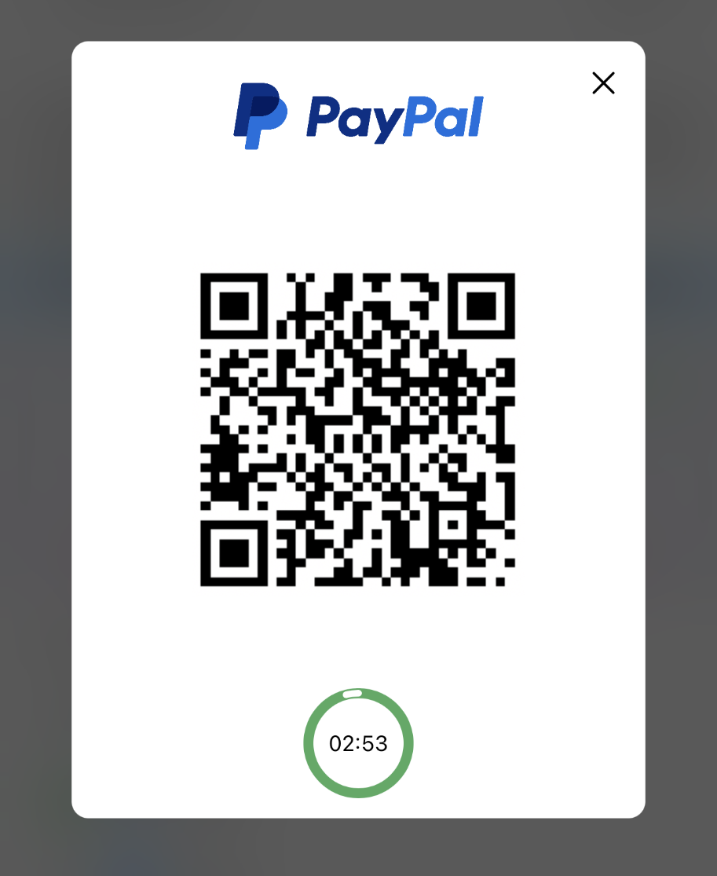
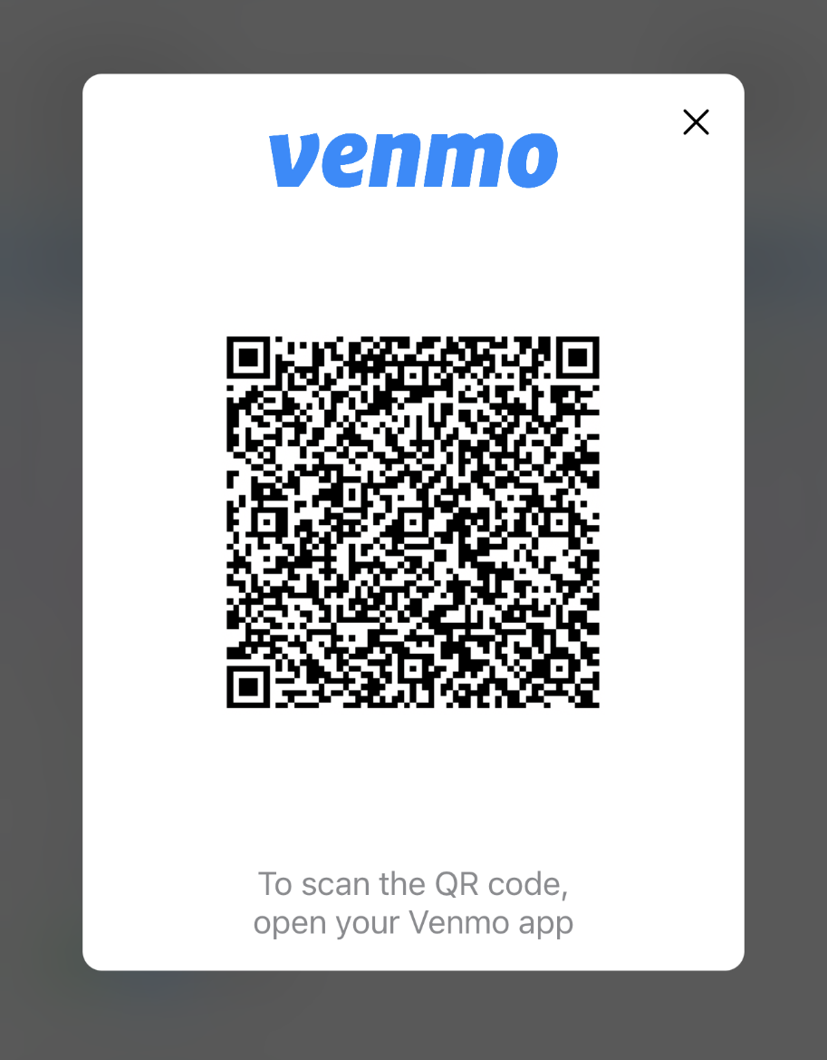
New Cookie Order
Only available for “Give cookies to customer now” orders
Step 3: Select how the customer would like to pay
Demo
Demo
Notes:
Script:
Next the Girl Scout will ask the customer how they would like to pay for their order. The customer can choose Credit Card, PayPal or Venmo. The PayPal/Venmo options are only available through the mobile app when the Give Cookies to Customer Now option has been selected. If the customer choose PayPal or Venmo and the Girl Scout has selected that option and clicked Place Order. A QR Code will appear, the Girl Scout can turn the phone around and the customer can scan the QR code with their phone to pay with their PayPal/Venmo account. (To the customer side volunteers can view the mobile app video)

Slide 13
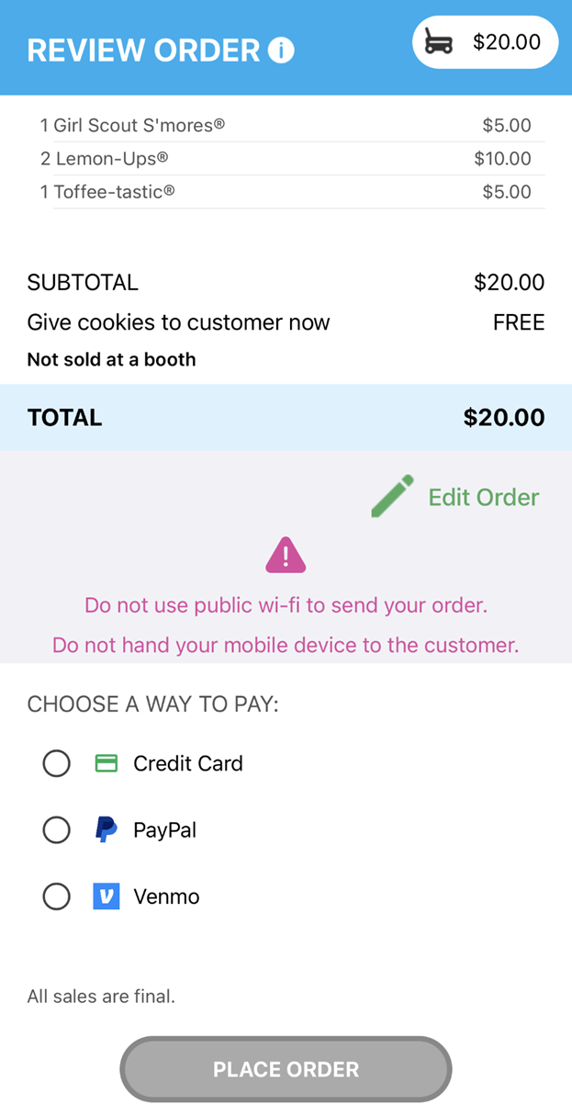
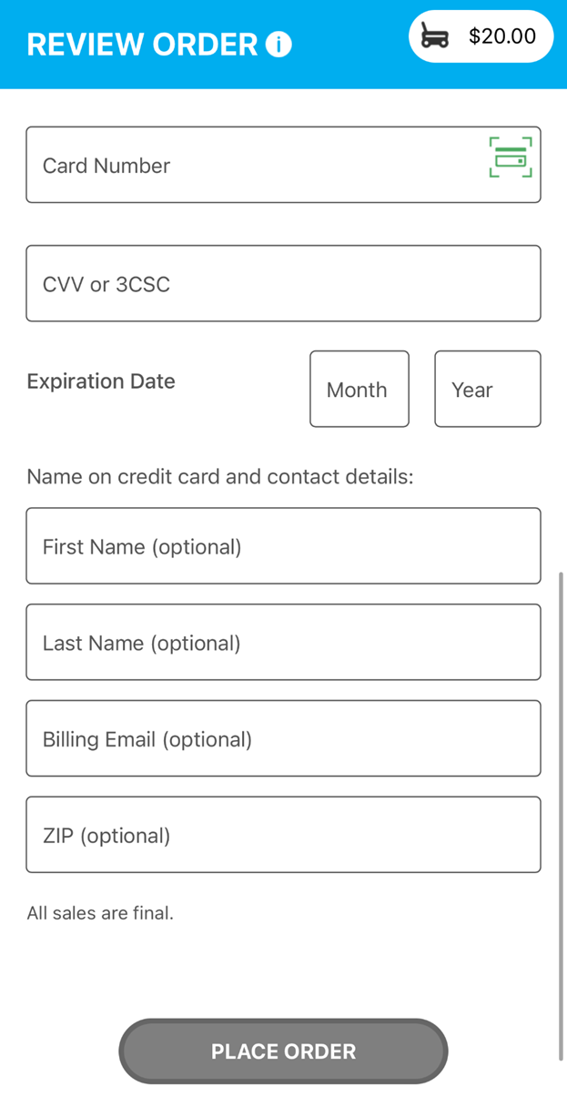
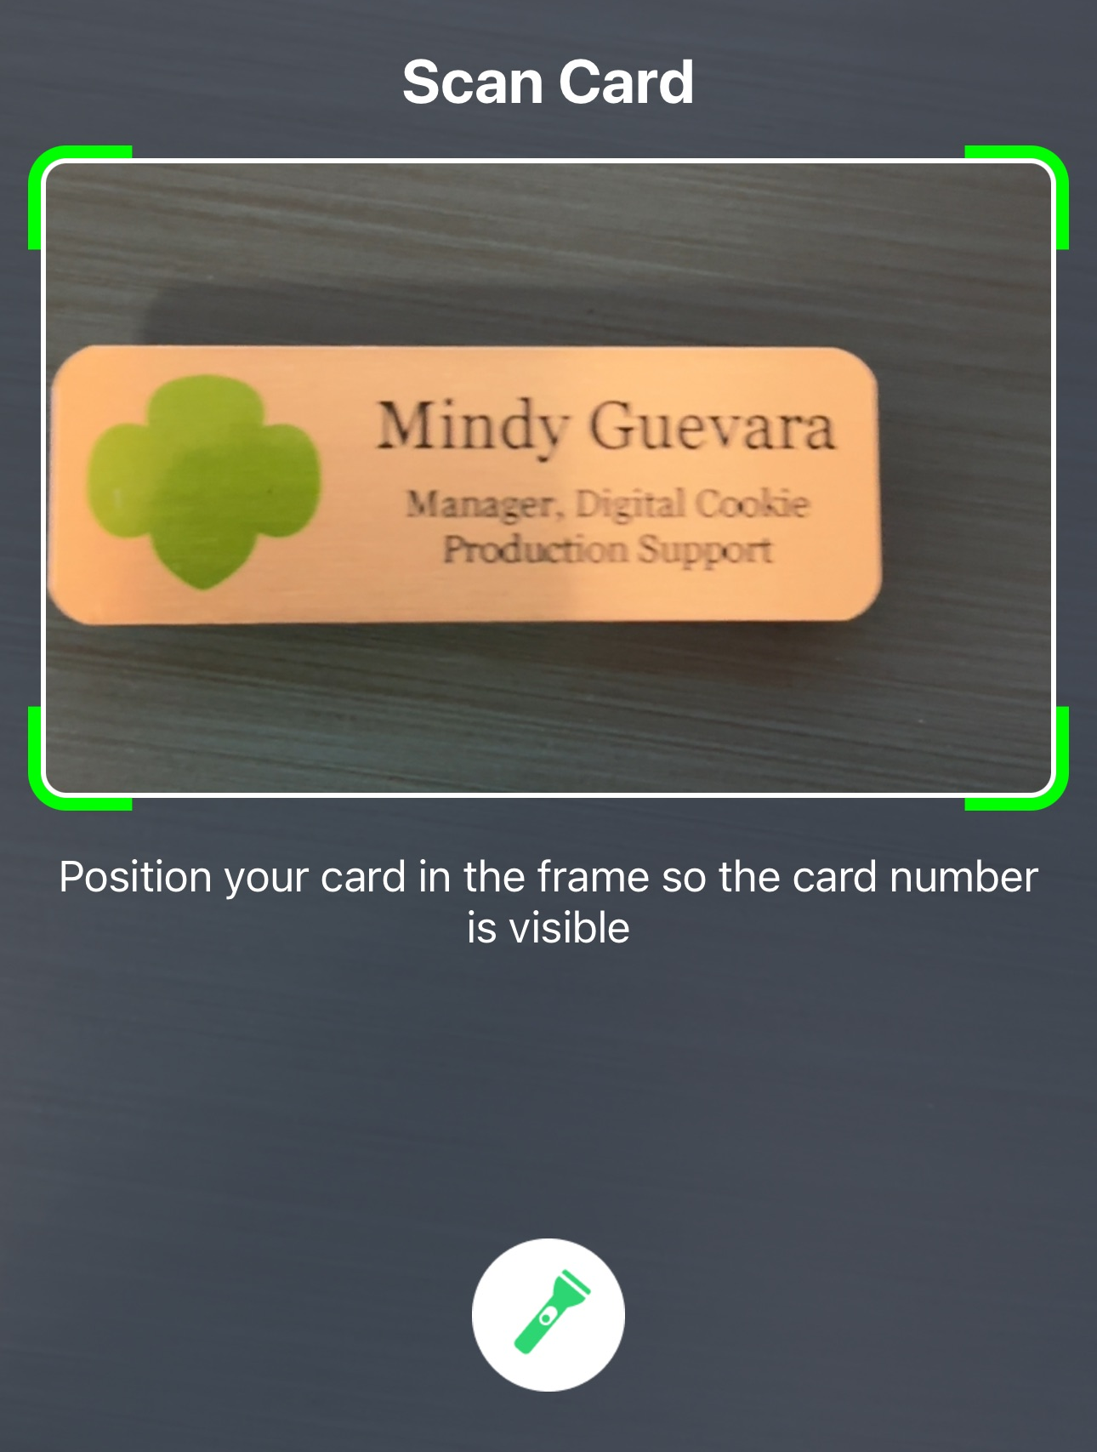
New Cookie Order
Contact details are now optional. Girl Scouts should still ask if the customer would like an email confirmation.
Step 3: Select how the customer would like to pay
Use the Scan Card feature instead of typing all the numbers.
Tip: Have good lighting and double-check the numbers before placing the order.
Notes:
Script:
If the customer choose to pay by Credit Card, the Girl Scout will scroll down on the phone to enter the payment details. Use the Scan Card feature instead of typing all the numbers. Make sure to have good lighting when using this feature. One the payment details have been entered, the Girl Scout can ask the customer if they would like to receive an email confirmation. While the customer details are optional now it is always good to ask and handy to have in case of any issues with the order.

Slide 14
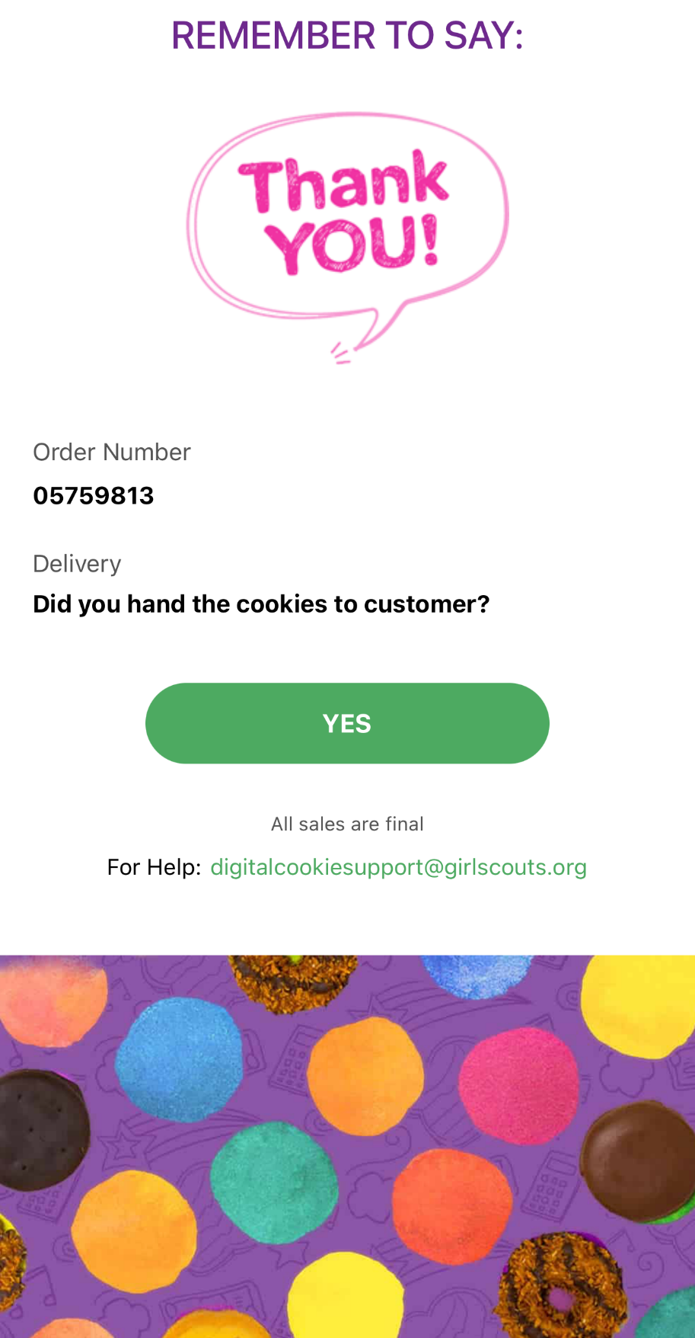
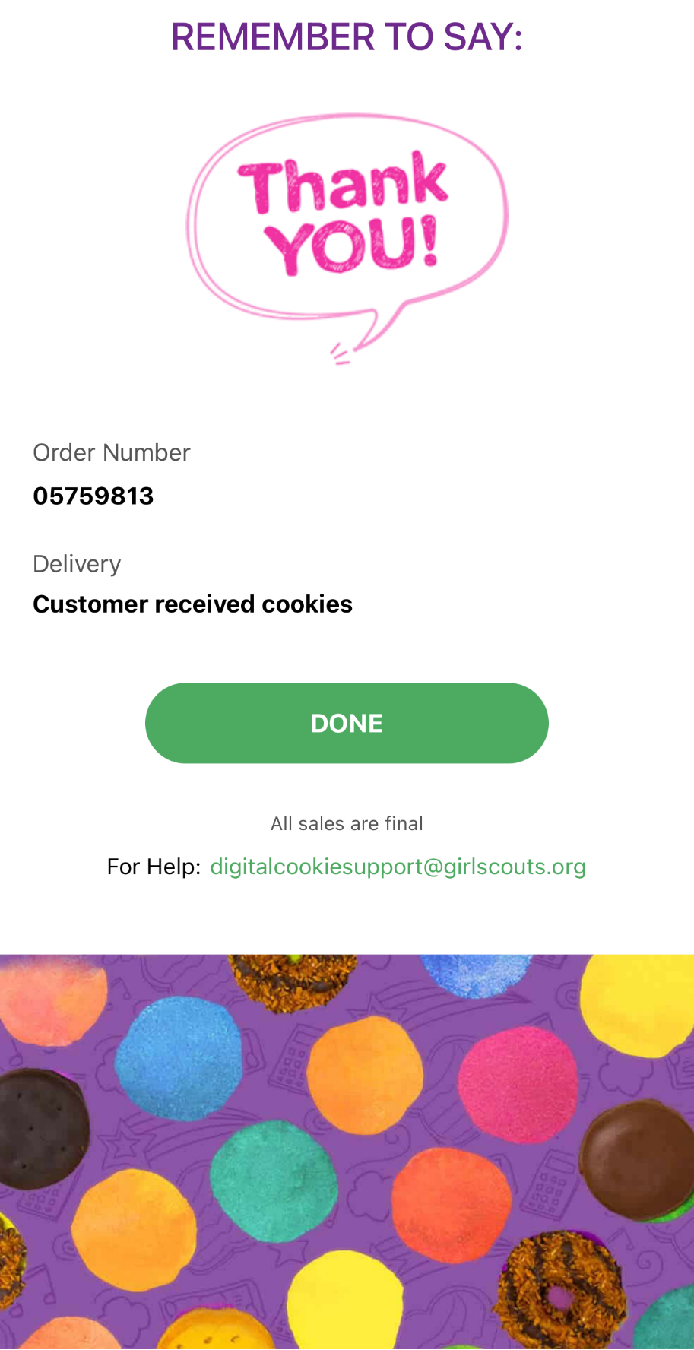
Once customers order has been successfully placed
Notes:
Script:
Once the order was successfully place, a screen will pop up on the Girl Scout’s phone to remind them to hand the cookies to the customer, and then select done with a reminder to say Thank You to the customer.

