Slide 2
Digital Cookie Troop Cookie Manager Training

Slide 3
Training Agenda
Brief Digital Cookie Overview
Troop Cookie Volunteer Experience
Customer Experience
Girl Scout / Caregiver Experience
Digital Cookie Help Center

Slide 4
What is Digital Cookie?
Notes:
Script:
What is Digital Cookie?

Slide 5
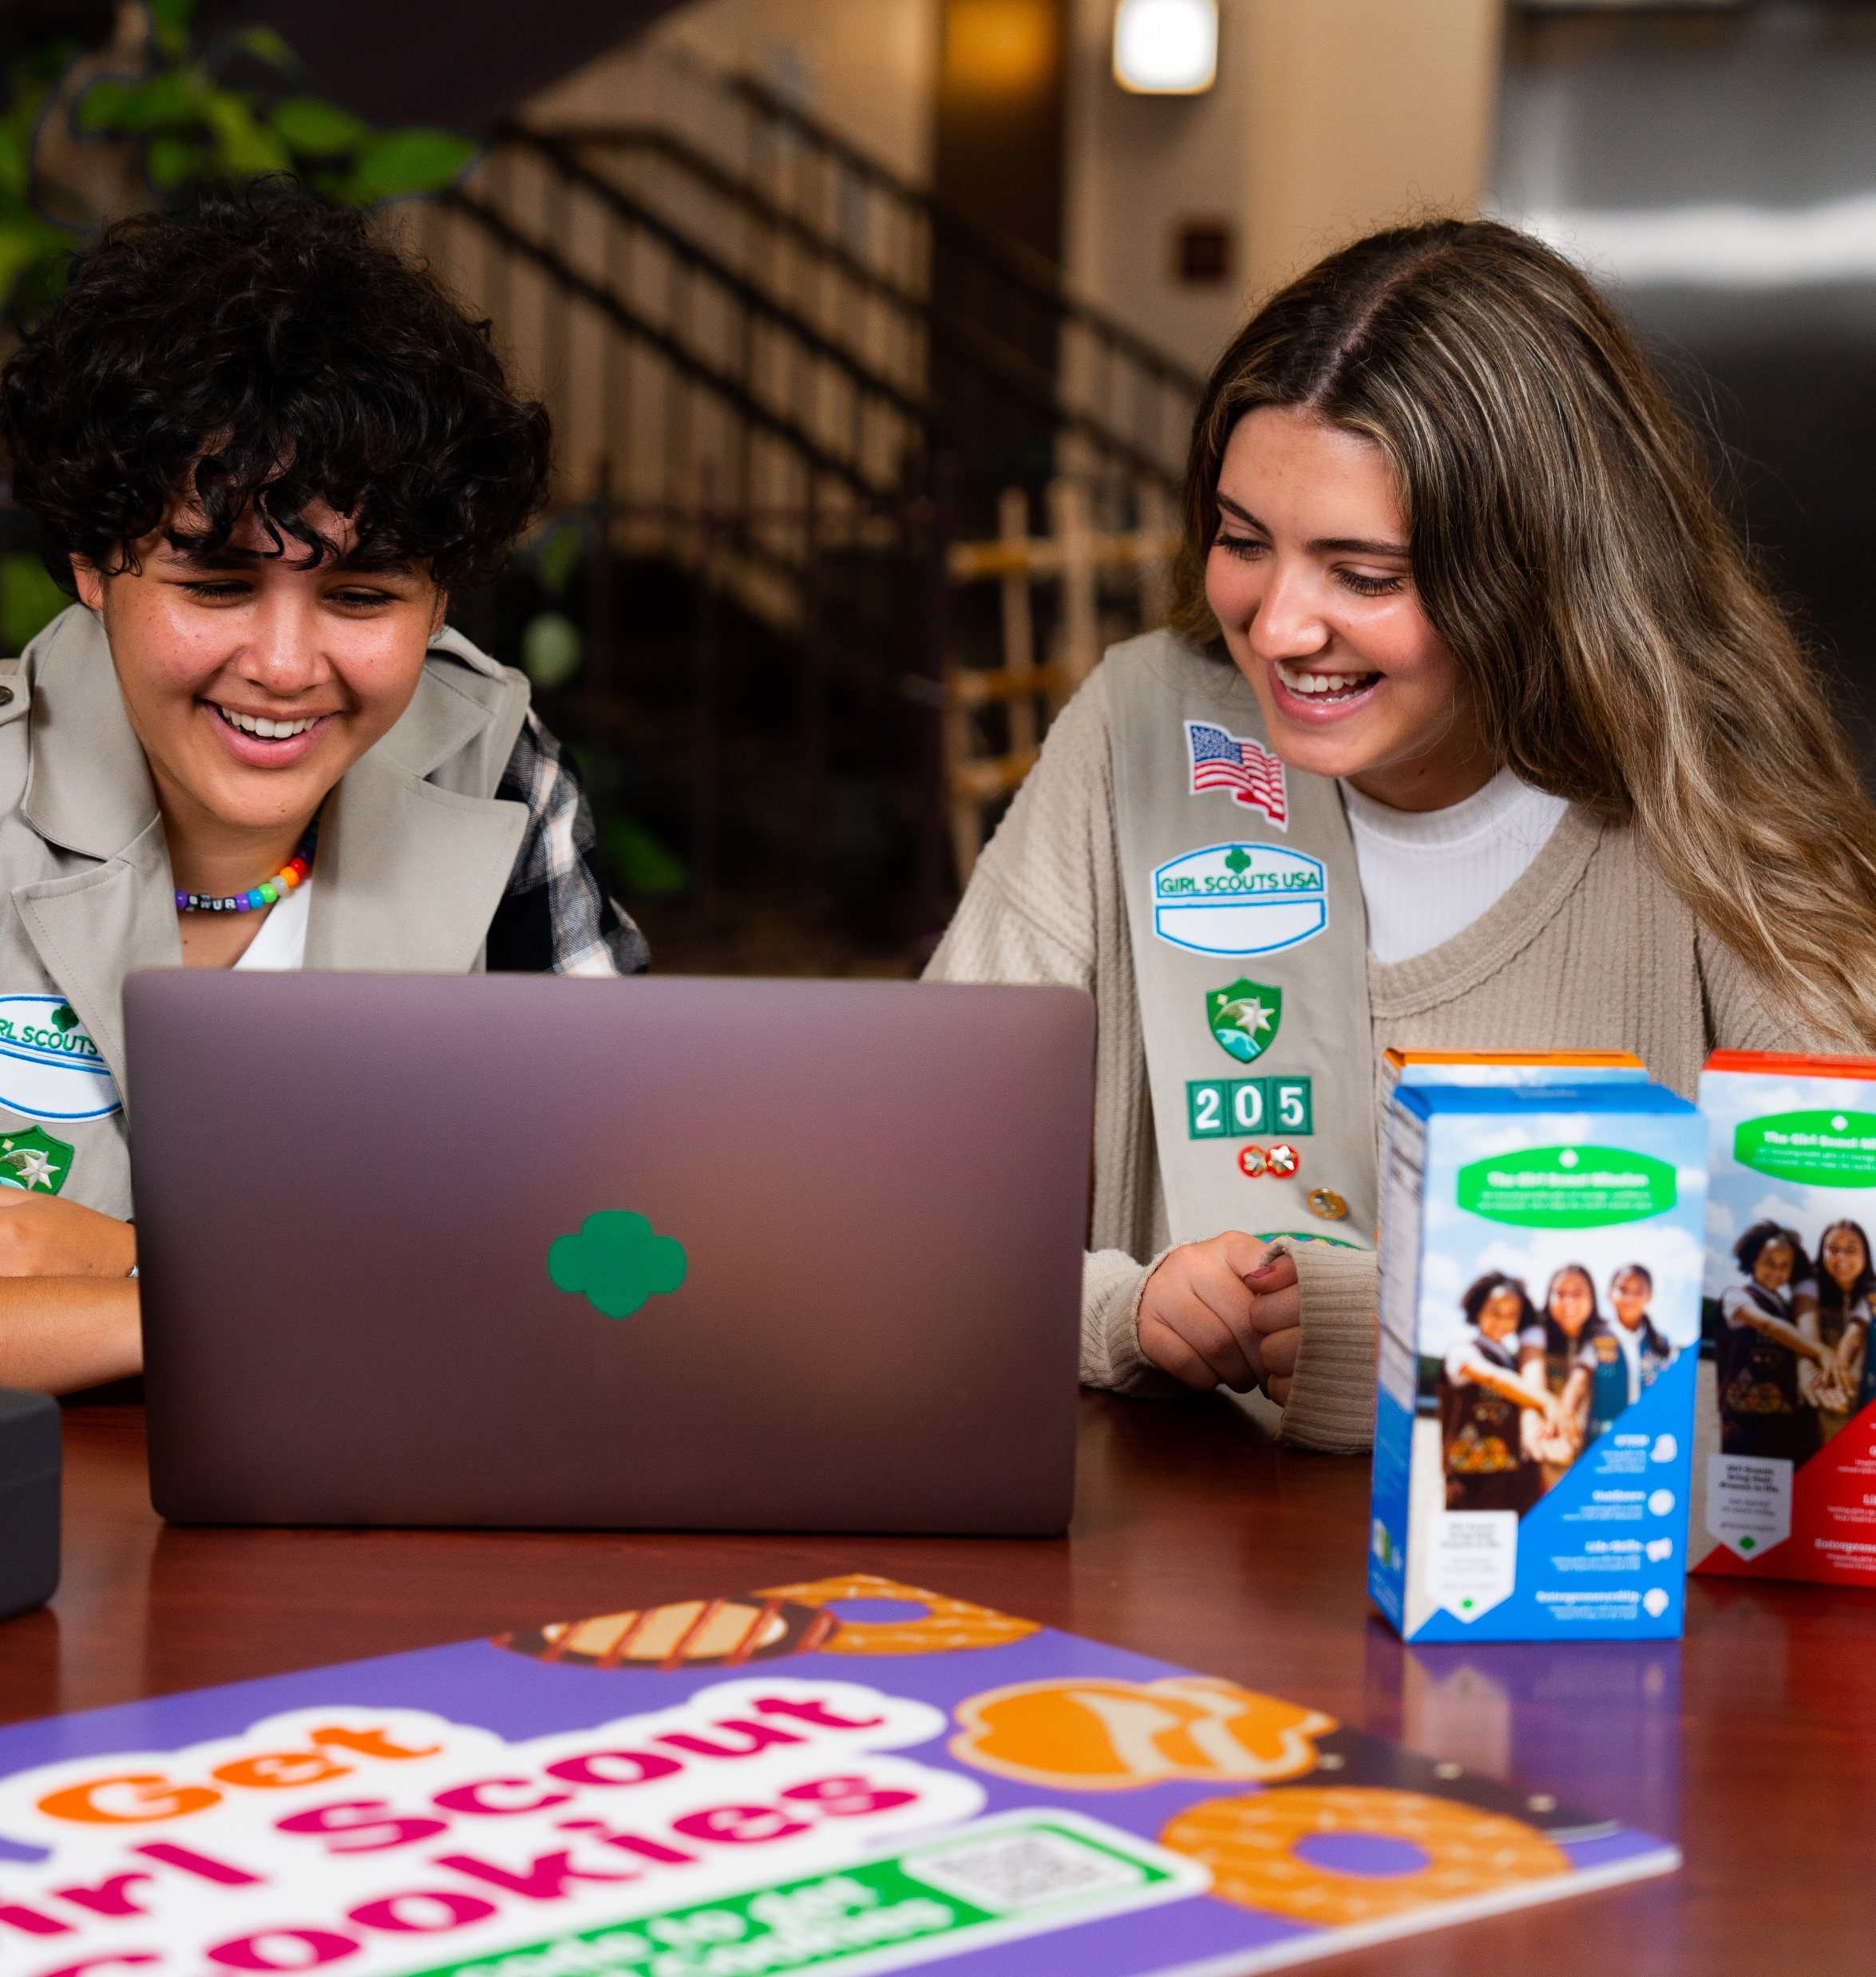
What is Digital Cookie?
Digital Cookie
Unified Online Selling Platform
Packed with fun, easy-to-use tools, Digital Cookie® delivers more ways to participate, more ways to sell, more ways to buy, and more ways to learn! And in addition, studies show Girl Scouts who use Digital Cookie® in combination with traditional sales often sell more cookies and reach their goals faster.
Notes:
Script:
In general, Digital Cookie is a unified online selling platform. It has easy-to-use tools and provides multiple ways for Girl Scouts to enhance their entrepreneurial skills. eCommerce has grown over the years and the platform gives Girl Scouts the opportunity to supercharge their cookie business. Now we know what Digital Cookie is lets see who all can use Digital Cookie.

Slide 6
Who Uses Digital Cookie?
Notes:
Script:
Who Uses Digital Cookie

Slide 7
Who Uses Digital Cookie
Girl Scouts create their own sites and send marketing emails to customers.
Girl Scout’s use Digital Cookie to supercharge their cookie business!
Girl Scouts and caregivers can manage their online sales, inventory, and financials using Digital Cookie.
Girl Scouts take orders and track purchases.
Troop Cookie Managers support Girl Scouts and families with visibility to their online activities.
Troop Cookie Managers use it to set up and manage sales for their troop specific online sales site.
Notes:
Script:
Digital Cookie is primarily used by Girl Scouts and Caregivers. Girl Scouts create their site and send marketing emails to customers. They can manage their online sales, inventory, and finances with their Caregiver. Girl Scouts can take orders and track the purchases from Customers.
Troop Cookie managers use Digital Cookie to support the Girl Scouts and families with visibility into their online activities. They also use it to set up and manage the troop site and online sales.

Slide 8
Troop Cookie Volunteer Experience
Notes:
Script:
The following slides will walk through the Troop Volunteer Experience in Digital Cookie.

Slide 9
Getting Started
Receive Email
Click “Register Now” From Email
Volunteer Terms and Conditions
December 20, 2024
Sender: “Girl Scout Cookies” email@email.girlscouts.org
Subject: Cookie season is almost here! Help your troop reach their goals with Digital Cookie.
Create Password and Login
Read and Accept T&Cs
Registration Tips
All users must register through their Digital Cookie registration email every year.
If you have a Girl Scout in your household and access for parents/caregivers has opened, you will need watch a safety video with your Girl Scout, accept the parent T&Cs and read and accept the Girl Scout Safety Pledge with your Girl Scout.
Make sure myGS account is updated with the correct email.
Add the sender’s email to your contacts list.
Check promotions, junk, and spam folders for email.
Tip Sheet: No Registration Email
Notes:
Script:
Watch for your registration email* from “Girl Scout Cookies” (email@email.girlscouts.org) with the subject “Cookie season is almost here! Help your troop reach their goals with Digital Cookie.” on December 20, 2024. If you don’t see it, make sure to search your “Promotions/Clutter/Spam”.
The email will be sent to the primary email on file in your myGS account, please make sure that is up to date prior to volunteer access date. If you don’t receive the registration email, use the tip sheets for additional steps to resend.
Once you find the email, open it and click on the Register Now button. You will be taken to Digital Cookie to create a password for this year and then log in to Digital Cookie with your email and password. Once logged in you will review the Volunteer Terms and Conditions and click the check box to accept. If you are a parent/caregiver and the parent access date has passed. When you first log in you will have parent Terms and Conditions to accept, a safety video to watch with your Girl Scout and a Girl Scout safety Pledge that will need to be read and accepted by your Girl Scout.
Once the terms and conditions have been accepted you will be taken to your troop volunteer dashboard.

Slide 10
Troop Cookie Volunteer Experience
Troop Dashboard
Six Sections
Notes:
Script:
There are six sections to your troop dashboard.

Slide 11



Troop Cookie Site
Pending Orders
Troop Site Sales
At a glance, see if:
The troop site has any pending orders to approve or deliver.
Girl Scouts in your troop have any pending orders to approve or deliver.
Quick access button to view orders.
Assign troop site lead
Set up troop cookie site
Copy troop site link or view QR Code
View the troop site’s progress towards their goal.
Cheers
Troop Online Sales and Marketing
Reports
The following reports are available for download:
All Order Data
Initial Order (If applicable)
Cookie Badges
Rewards Selection
Quick access button to send a Cheer to a Girl Scout in your troop.
Monitor your troop’s sales and Girl Scouts' Digital Cookie progress.
Notes:
Script:
On your troop dashboard you will see six different sections.
Troop Cookie Site: when you first log in you will see a Get Started button, once the troop site is set up this box will have the troop site links and QR code.
Pending Orders: In this section you will see if the troop site has any pending orders to approve or deliver and if Girl Scouts in your troop have any pending orders to approve or deliver.
Troop Site Sales: This progress bar is for troop site orders only and does not include any Girl Scout orders.
Cheers: here you will find a quick access button that will take you to the Cheers page where you can send a Cheer to a Girl Scout in your troop.
Troop online Sales and marketing: In this section, you can monitor the troop site sales and Girl Scout’s Digital Cookie progress.
Reports: This section contains up to four reports to view that can help you manage the Digital Cookie activity for the Girl Scouts in your troop:
All Order Data will show you details on every order for every girl.
Initial Order (If applicable) will show you the initial paper order card entry by the parents to allow you to compare what is in the baker software if desired.
Cookie Badges will let you know if girls are completing any of the Cookie Business badges and/or the Family Entrepreneur Pins. Encourage them to complete these with their families to increase their cookie program learnings!
Rewards Selection will be helpful if your council enabled girls to select their rewards in Digital Cookie. You simply pull this report and enter their choices into the baker software without needing to track down each choice for each girl in the troop.
For a full review of the troop dashboard, please see the Volunteer Dashboard tip sheet and video walk through (available in Nov.).

Slide 12
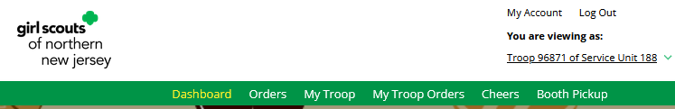
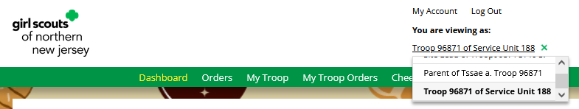
Troop Dashboard
Notes:
Script:
If you have multiple roles, (Girl Scout(s) in your household, volunteer for multiple troops or a service unit level volunteer) you will be able to easily toggle between your roles, directly from the dashboard using the drop-down arrow under the role you are currently logged in as.

Slide 13
Troop Site Setup
Notes:
Script:
Your Troop Cookie Site links will help your troop make sales online instead of, or in addition to, your regular in person cookie booths. Setting up the troop site will also allow Girl Scout’s to take payment on behalf of the troop using the Digital Cookie mobile app at cookie booths.
The following slides will walk you through setting up your troop site.

Slide 14
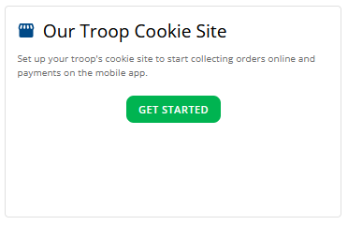
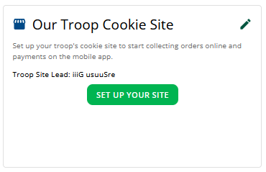
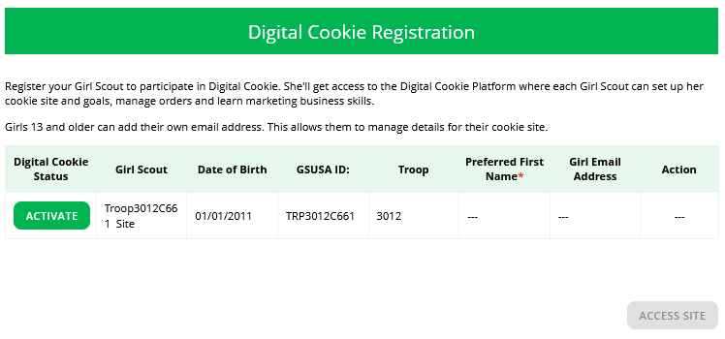
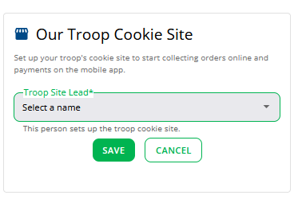
Troop Site Setup
Step 1: Click Get Started
Step 3: Click Set Up Your Site
Step 2: Select a Troop site lead
Step 4: Activate the Site
Notes:
Script:
You can activate your troop site in four steps:
Step 1: click the Get Started button. This button is only on the dashboard prior to the site being activated.
Step 2: Select a Troop Site Lead, if your troop has multiple volunteers, you will select which volunteer will be the “site lead” from the drop down. The Troop site lead will be responsible for working with the Girl Scouts in the troop to set up the troop site and will have access to the troop site’s home page similar to a Girl Scout’s home page.
Step 3: Once you save the troop site lead, if you choose yourself, you will see the Set Up Your Site button on the dashboard. If you assigned a different volunteer to be the site lead, the next time they log into Digital Cookie they will see the Set Up Your Site button on the troop dashboard.
Step 4: After clicking the Set Up Your Site button, you will be taken to the Registration page where you can Activate the troop site. If you have Girl Scouts in your household, you will see the here too. After Clicking the Activate button, you will be able to click the Access Site button. This will take you to the troop site and you will be ready to set up the site.

Slide 15
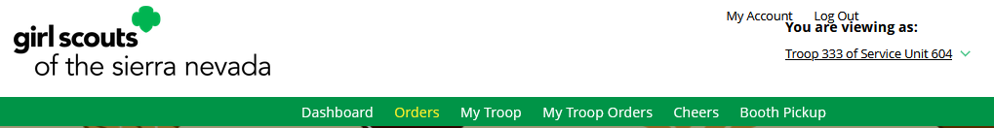
Orders Page
Notes:
Script:
The next few slides will cover how volunteers can use the Orders page.

Slide 16
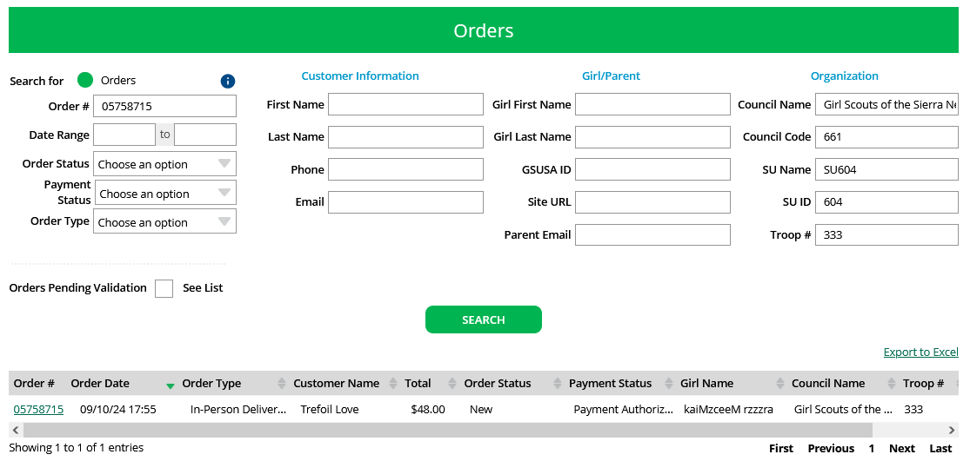
Searching for Orders
ABC/LBB
Notes:
Script:
The “Orders” tab allows you to lookup orders that were placed for all the Girl Scout’s in your troop as well as refund in-person delivery, donation, an cookies-in-hand orders (orders placed on mobile app).
Once you are on the Orders page, you can look up the order a few different ways. The recommended lookup options are Customer Order #, Customer Email address, Parent Email Address, Girl Name (first and last), or Customer Name (first and last, min 2 letters). Using more than one can cause the results to not appear properly. You can also narrow down the orders by selecting the Order Status, Payment Status, or Order Type.
After entering the information and clicking Search, the order or orders will appear in the search. From here you can quickly see some of the order details. To see the specific order details, click the order number.

Slide 17
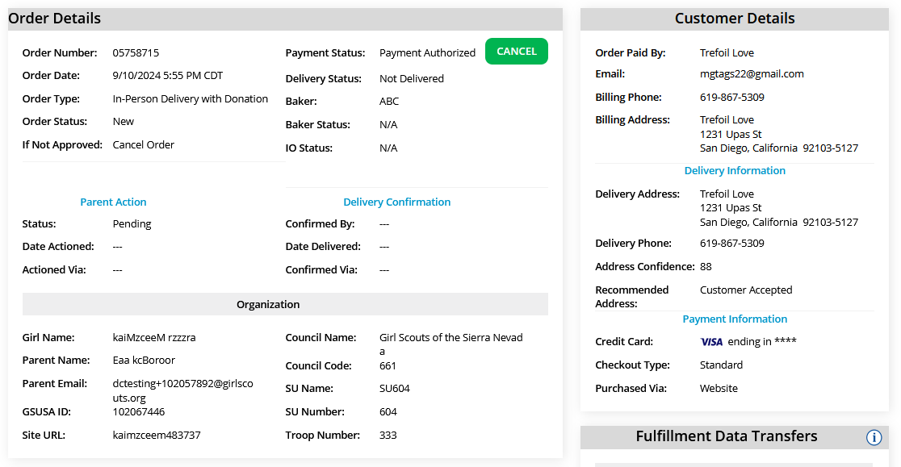
Order Details
Notes:
Script:
The Order Details page has the full details of the order including order type, parent action, and customer information.

Slide 18
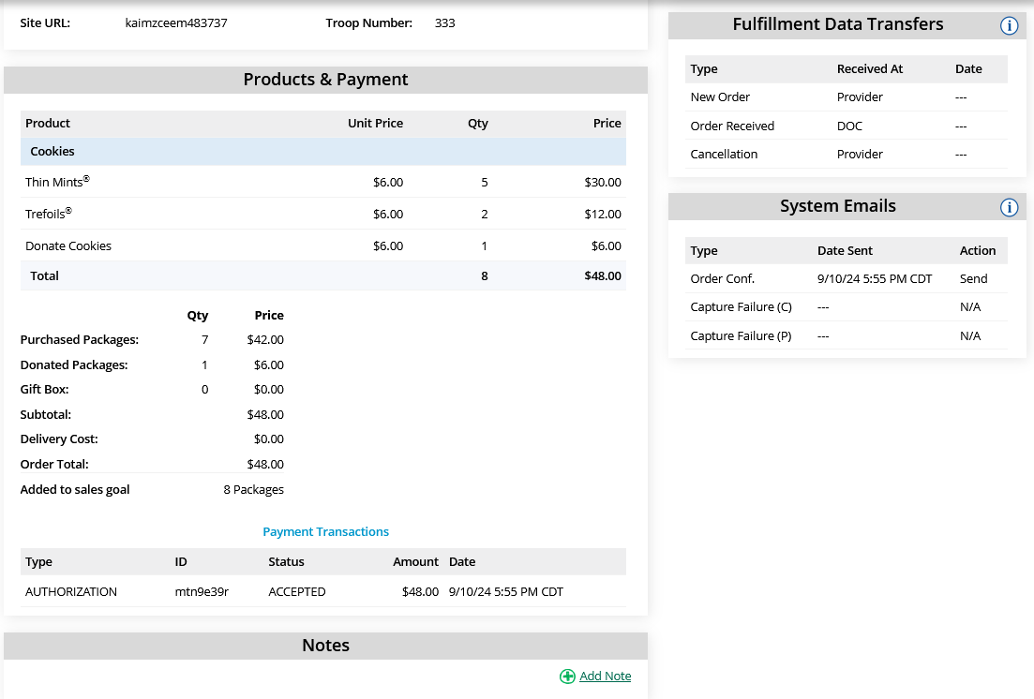
Order Details
Notes:
Script:
The bottom half of the Orders Detail page lists the variety of cookies and how much the customer paid, payment status, and if it was a shipped order, you would see the fulfillment status.

Slide 19
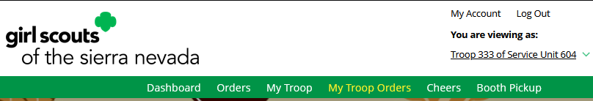
My Troop Orders Page
Notes:
Script:
The next slide will cover the My Troop Orders page.

Slide 20
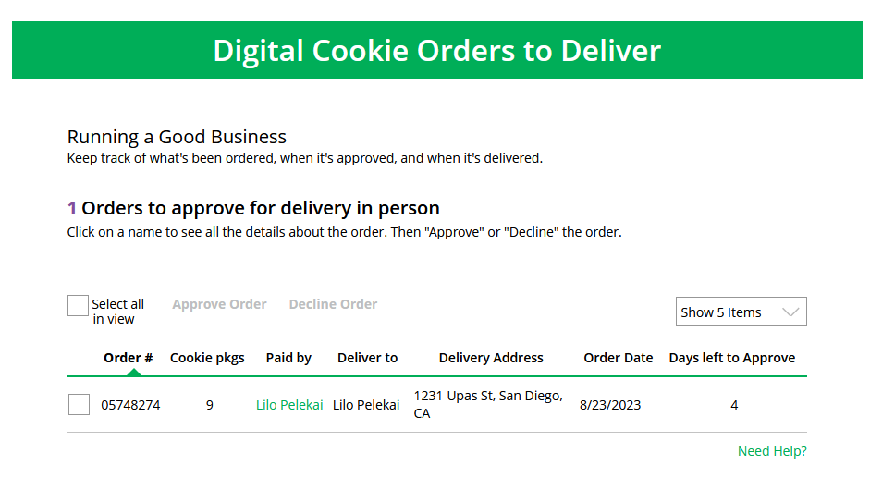
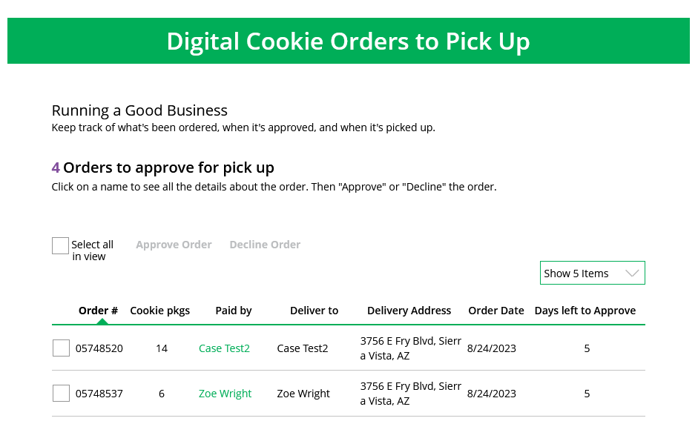
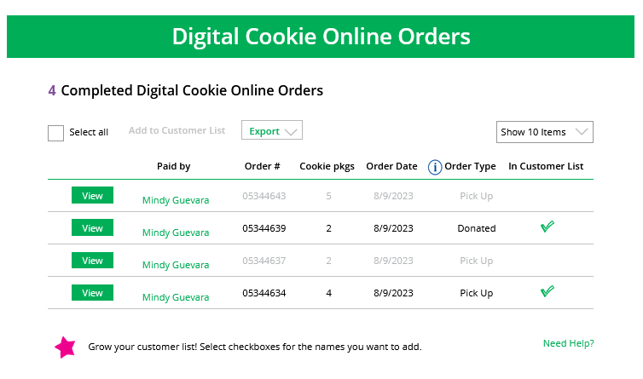
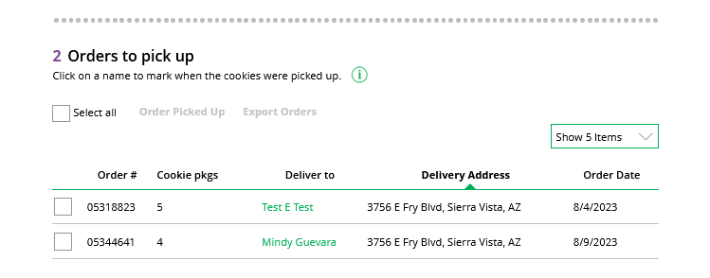
Use this page to see orders place on the troop’s cookie site
Notes:
Script:
This page works the same as the Girl Scout orders page. You can approve/decline Girl Scout delivery orders as well as pickup orders. When you approve a pickup order, it moves down to the Orders to pick up section.
Here you can export a list or find additional details on each order to prepare them for pick up. Once they are picked up, you can mark them as such in this section as well.
Once the order is complete it moves down to the bottom “completed” section, where you will find shipped and donation only orders placed for your troop. The greyed-out orders are canceled/declined orders.

Slide 21
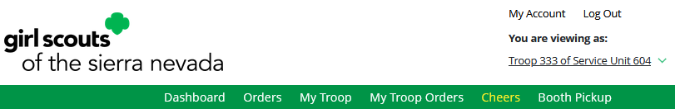
Cheers Page
Notes:
Script:
The next slide will cover the Cheers page.

Slide 22
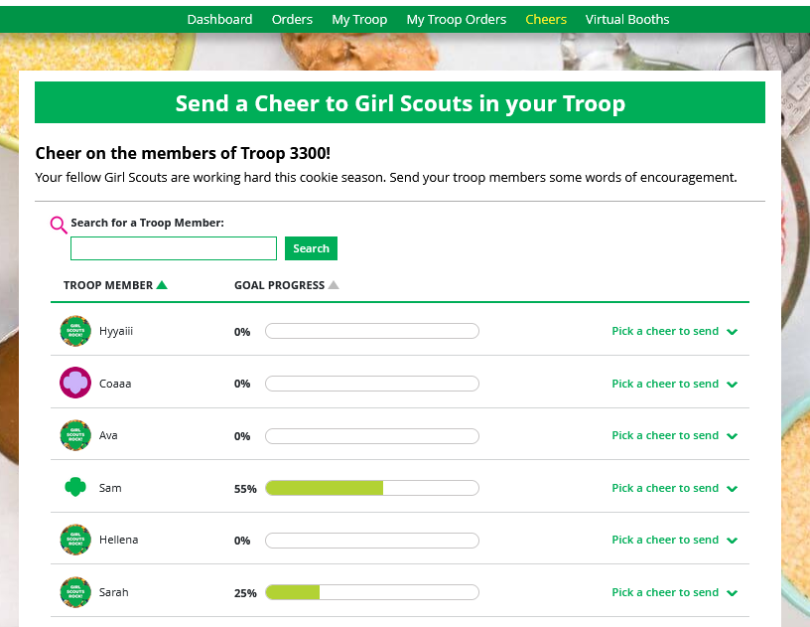
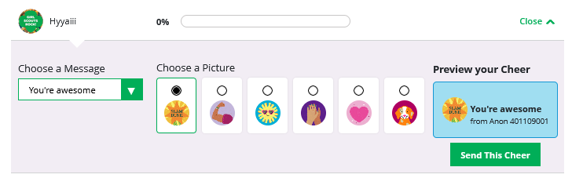
Cheers page
You can send Cheers to Girl Scouts in your troop!
Click the drop down next to the Girl Scout to view the message and picture options, then preview and send your Cheer to that Girl Scout.
Notes:
Script:
Troop Volunteers can send the Girl Scouts in their troop cheers the same way troop members can send them to each other. The difference is that Girl Scouts can’t cheer back to volunteers.
On the Cheer’s page, you can see the Girl Scouts in your troop and the percentage of sales towards their goal. You can click the “Pick a cheer to send” drop down next to the name of the Girl Scout you wish to cheer.
Then you will see a choice of .gif images and short messages to send. As you select the message and image you will see a preview of the cheer and then can click “Send this Cheer.”
The Girl Scout will get a notification the next time she logs in on her Dashboard that she received a cheer. Don’t forget Girl Scouts are unable to send a Cheer back to volunteers or customers.

Slide 23
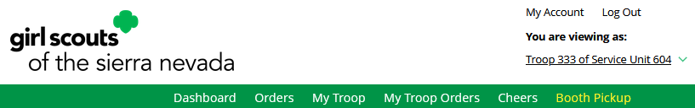
Booth Pickup Page
Notes:
Script:
The next slide will cover the Booth Pickup page.

Slide 24
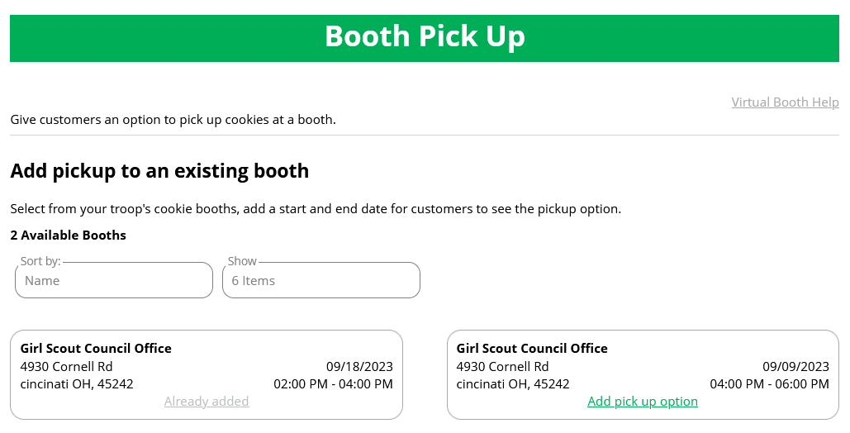
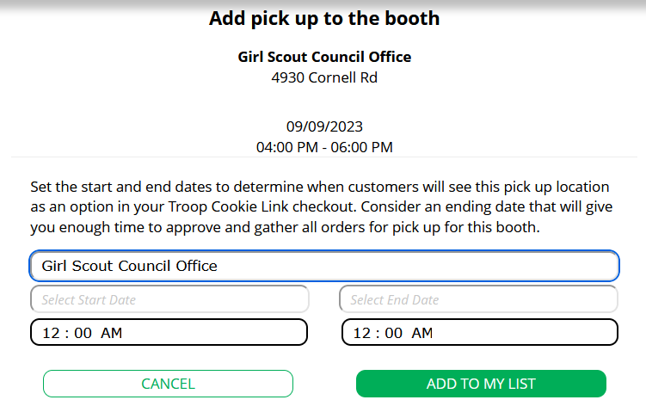
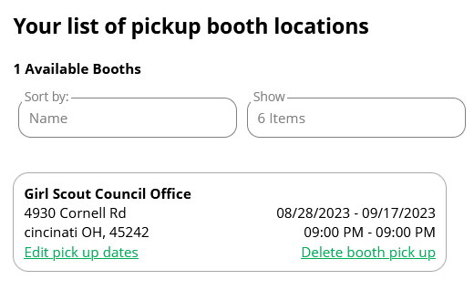
Click “Add pick up option”
Set date and times
The booths listed in Digital Cookie are what the troop has signed up for in the baker system.
Edit or delete if necessary
Notes:
Script:
Your Booth Pickup page where you can add the option for customers to place an order online and pick it up at your troop’s upcoming cookie booth.
To activate that option for your troop customers, there are just a few steps to set up that option using the cookie booths you have signed up for.
Start by selecting an existing cookie booth from your list by clicking on “Add pick up option”
Once you have selected a booth to add a pickup option for customers to, you will need to enter a few details about when the customer will see that pickup location as an option.
NOTE! Consider ending that option 12-24 hours before the booth sale will begin so you have time to review and approve all orders. If you have concerns about inventory for pickup orders, consider ending the option even earlier so you can secure the necessary product for the orders.
If you need to edit or delete your pickup locations, you can view your list of pickup locations and edit or delete them.
Important! If you cancel a booth in the baker’s system, you must delete the booth from here so customers can no longer select it as a pick-up option.
Check your orders tab for any orders that were scheduled to be picked up and make alternate arrangements or cancel and refund them

Slide 25
Digital Cookie Customer Experience

Slide 26
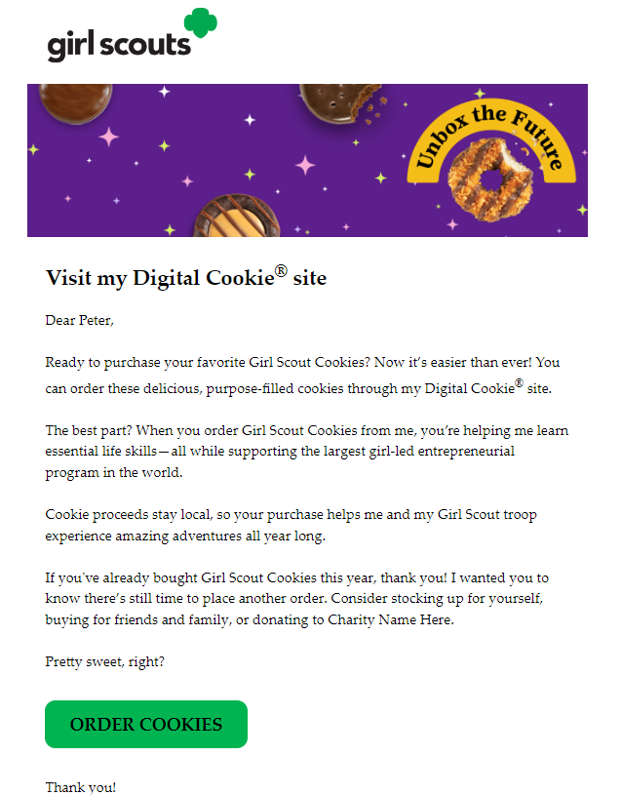
Customer View-Email
Order Cookies Link
Notes:
Script:
Customers either receive a link to a Girl Scout’s site from a mutual connection or receive a Girl Scout’s email announcing that cookie season is open.
Customers will click the “Order Cookies” link in the email and be taken to the Girl Scout’s Digital Cookie site.

Slide 27
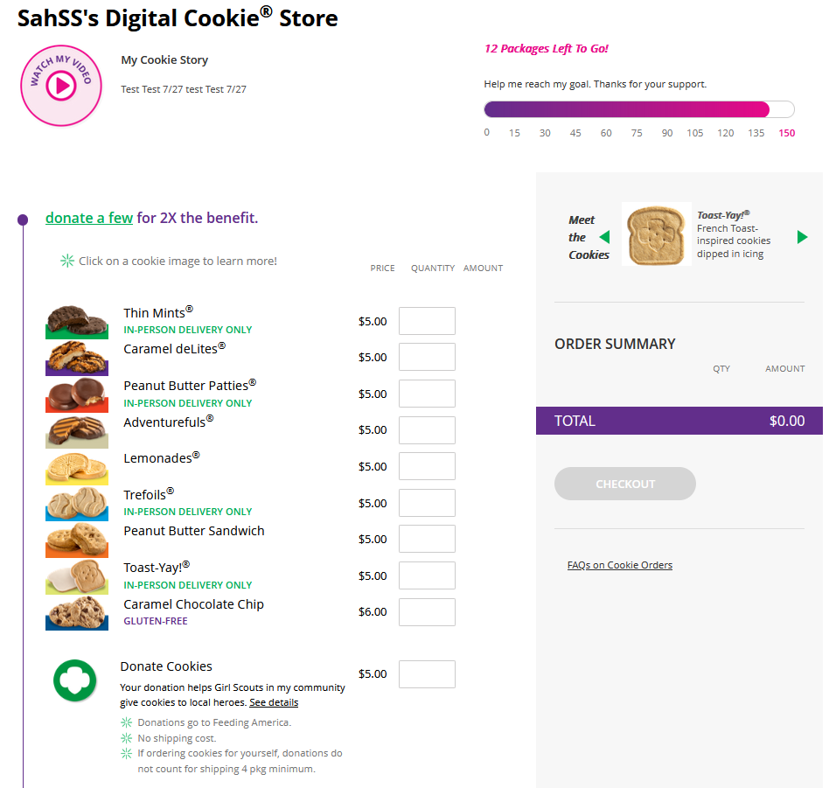
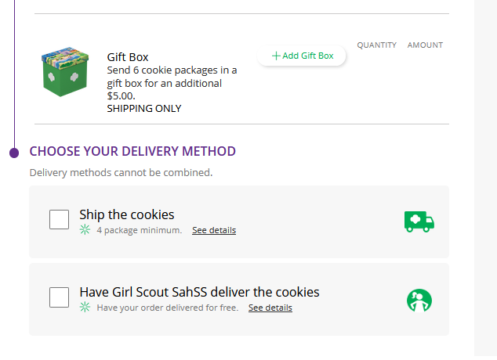
Customer View-Placing Order
Customer enters package quantity
Select Delivery Method
Checkout
Notes:
Script:
When a customer lands on the Girl Scout’s cookie site, they can see the cookie varieties, read the Girl Scout’s cookie story and see the progress to the Girl Scout’s goal.
As customers order packages, the total amount updates.
After selecting the cookies, customers will select the delivery method
Once customers are satisfied with their order, they will simply click the “Checkout” button.

Slide 28
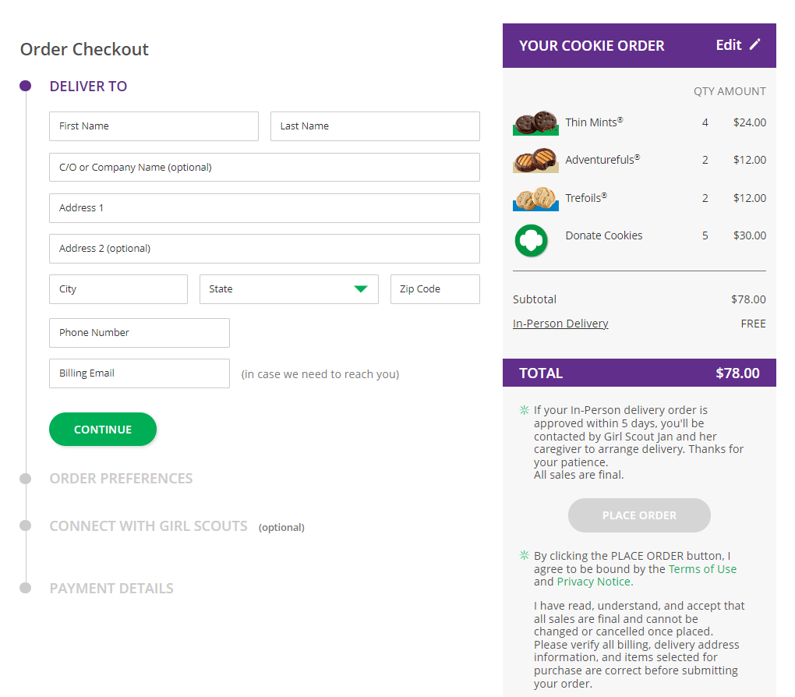
Customer View-Checkout
Additional Information from Customers
Notes:
Script:
Customers are then taken to a checkout screen to complete basic delivery and billing information.
The next screens (Order Preferences, Connect with Girl Scouts, and Payment Details) ask customers to:
Choose a second option if Girl Scout delivery is not approved.
Indicate if they want membership or volunteer information (optional).
Share if they were Girl Scouts (optional).
Complete credit card information.

Slide 29
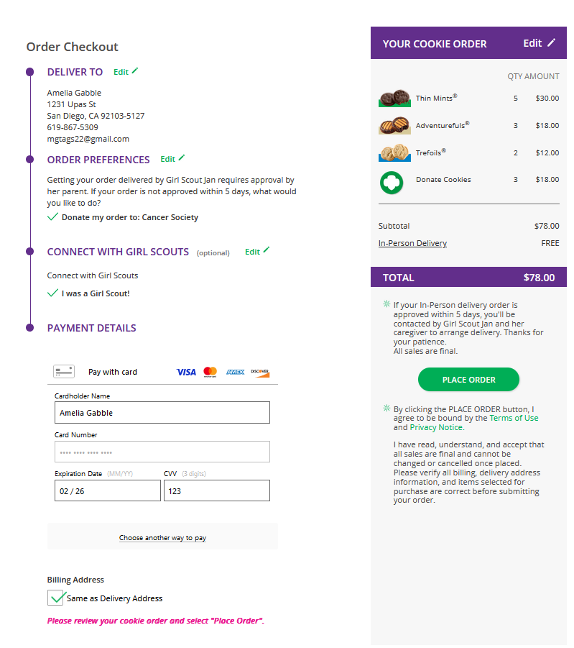
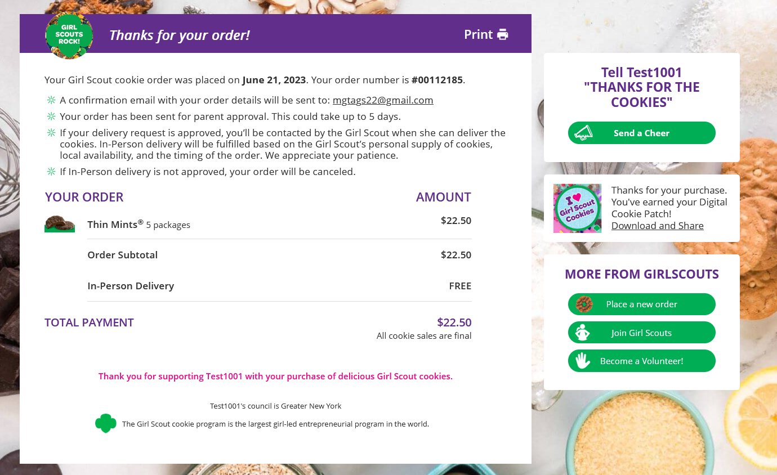
Customer View-Confirmation
Send Girl Scout a Cheer
Place another order
Notes:
Script:
Once customers have completed the information and clicked continue at each step, they will click the “Place Order” button
Customers then see an order confirmation screen that includes the option of placing a new order in case they want to send some to a friend!
Customers will then receive a series of emails depending on their order delivery method.
See Customer Experience tip-sheets for more details on the emails customers receive

Slide 30
Digital Cookie Shipping Fees
Package Bracket | Digital Cookie 2023-2024 Consumer Charged Flat Fee
4-8 | $12.99 (tier A)
9-12 | $14.99 (tier B)
Digital Cookie Shipping Fees
For orders of 13 packages or more shipping is calculated as follows:
13 packages of cookies: tier B (12 packages) + tier A (1 more package) = $27.98
25 packages of cookies: tier B x 2 (24 packages) + tier A (1 more package) = $42.97
$5.00 surcharge to orders shipping to Hawaii, Alaska, Puerto Rico, APO/FPO/DPO, Guam and US Virgin Islands
Don’t make the decision for your customers, the answer is always no unless you ask.
Customers want the cookies and are willing to pay shipping
They have the option to not purchase shipped and still donate-that is more sales than not asking
Notes:
Script:
There are a lot of people who don’t know a Girl Scout and want the cookies and are willing to pay shipping to both get the delicious cookies and support your Girl Scout.
Customers can decide if they want to purchase shipped, or donate a box or two, or nothing at all.

Slide 31
Girl Scout and Caregiver Experience
Notes:
Script:
The following slides will walk-thru the Girl Scout and Caregiver Experience

Slide 32
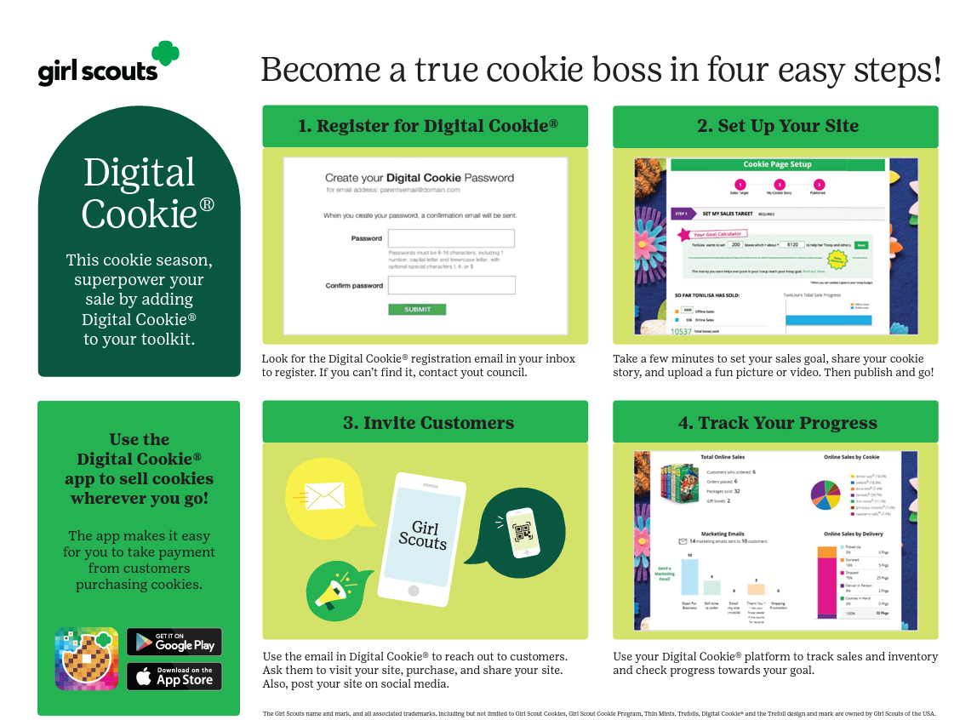
Notes:
Script:
Caregivers can help Girl Scout set up Digital Cookie in just four easy steps! We will cover these steps in more detail in this training.

Slide 33
Step 1: Register
Receive Email
Click "Register Now" In Email
No Registration Email
December 20, 2024
Create Password and Login
View the “No Registration Email” Tip Sheet
Sender: “Girl Scout Cookies” email@email.girlscouts.org
Subject: It’s time to register your Girl Scout for Digital Cookie!
All users must register through their Digital Cookie registration email every year.
Check promotions, junk, and spam folders for email.
Make sure myGS account is updated with the correct email.
Add the sender’s email to your contacts list.
Notes:
Script:
Watch for your registration email* from “Girl Scout Cookies” (email@email.girlscouts.org) with the subject “: It’s time to register your Girl Scout for Digital Cookie!” on December 20, 2024. If you don’t see it, make sure to search your “Promotions/Clutter/Spam” folders.
The email will be sent to the primary email on file in your myGS account, please make sure that is up to date prior to your access date. If you don’t receive the registration email, use the tip sheets for additional steps to resend or look up to see what email is on file for your Girl Scout.
Once you find the email, open it and click on the Register Now button. You will be taken to Digital Cookie to create a password for this year and then log in to Digital Cookie with that password and email.

Slide 34
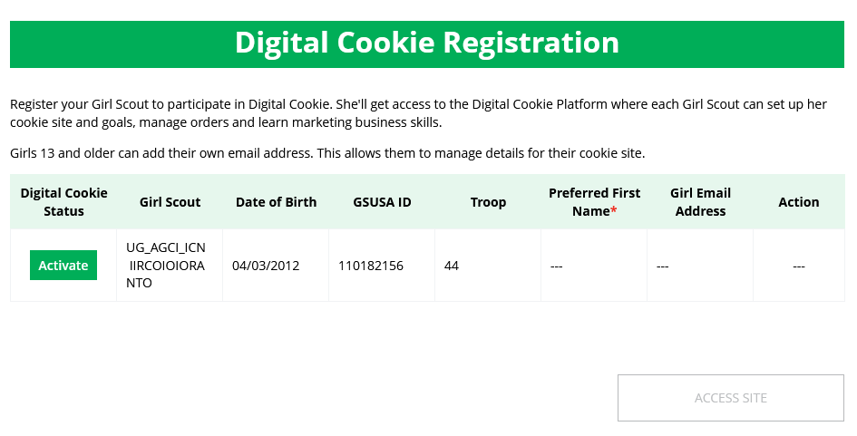
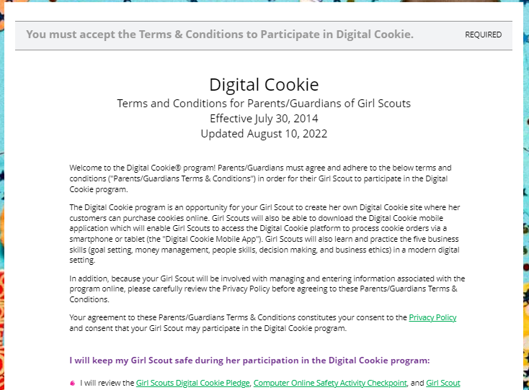
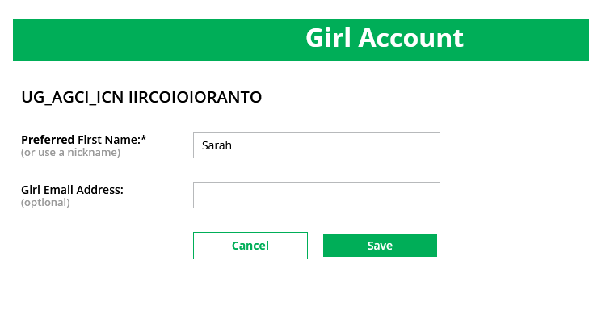
Step 1: Register
Activate Girl Scout(s)
Watch Safety Video with Girl Scout
After clicking the Activate button you will be able to update your Girl Scout’s preferred name. This name will be on the storefront and in the customer’s emails.
At the end of the video, you will need to click the green continue button.
Approve Terms and Conditions and Safety Pledge
13+ Girl Scouts
You will also have the option to add your Girl Scout’s email if she is 13 or older. Do not add the email address you used to log into Digital Cookie, This is optional, skip this box if you do not want to add an email.
Be sure to read the safety pledge with your Girl Scout and check the box to accept both documents.
Notes:
Script:
When you first log in, you will need to watch a safety video, make sure your Girl Scout(s) is available to watch with you! There will be a Continue button at the end. You can’t proceed any further until the full video has been viewed.
Next you will, read and accept the Terms and Conditions agreement.
Then the “Girl Scout Safety Pledge” will appear. Be sure to read it to/with your Girl Scout(s) and check the box for “accept” and click “continue.”
Once you have accepted the terms and pledge, you will then be taken to a screen to activate your Girl Scout(s) for the Digital Cookie program and update their preferred name if desired.
If the Girl Scout you are activating is 13 or older, you have the option to enter an email address. The Girl Scout will then be able to set up the site and monitor Digital Cookie. (Note, the email address for a Girl Scout 13+ must be unique and not in use in Digital Cookie).
Girl Scouts under 13 will log in, in partnership with their caregiver and do not need a separate email address.
After activating all of your Girl Scouts (if you have multiple), you will click the “Access Site” button to be taken to the first Girl Scout’s home page. Once you have registered, watch your inbox for a registration confirmation email and save this email where you can find it during cookie season!

Slide 35
Message from Council
My Sales Goal
My Cookie Site
Note of encouragement from Girl Scouts of Southeastern New England
Digital sales progress bar and number of packages credited by troop volunteer.
Set up cookie site and then copy cookie site link or view QR Code.
Pending Orders
Cheers
Pins & Badges
At a glance, see if your Girl Scout has any orders that need to be approved or marked as delivered.
Quick access button to “Send a Cheer” to a Girl Scout in your troop.
Track the progress toward completing the Cookie Business Badges and Cookie Entrepreneur Family Pins.
Notes:
Script:
Once you log in to Digital Cookie you will arrive on your Home page. You have 7 different sections on the Home page that help you support your Girl Scout’s Digital Cookie sales.
Message from Council: a note of encouragement from us for the sale.
My Sales Goal: See your Girl Scout’s progress toward her goal and see how many cookies the troop cookie volunteer has assigned to your Girl Scout.
Donated and In hand orders appear right away.
Shipped orders appear in the graph when the order ships. This can take a few days, orders don’t ship on weekends and holidays.
In-person delivery orders appear when the order is approved
Girl Scouts can add offline sales under the site setup page so customers can see a true representation of her sales.
My Cookie Site: First you will see a button to set up the Girl Scout cookie site, once it is set up you will have easy access to the link and a QR Code to share with customers.
Pending Orders: In this section you will be notified if there are orders that need to be approved and reminded of orders that need to be marked as delivered.
Cheers: Here you will find a quick access button that will take you to the Cheers page where your Girl Scout can send a Cheer to a Girl Scout in the troop and see what Cheers have been sent from Girl Scouts, volunteers, and customers.
Pins & Badges: This section will let you know when your Girl Scout has completed a cookie pin or badge. Once completed the steps on the Badges page, the completed pin or badge will show in color.

Slide 36
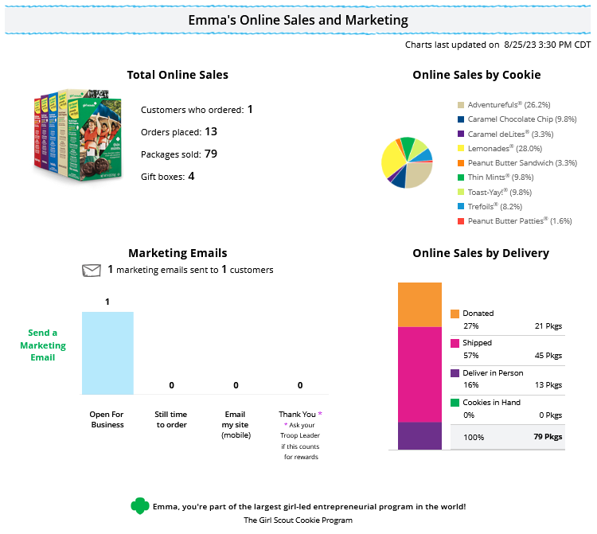
Online Sales and Marketing
Notes:
Script:
The seventh section, at the bottom of the Home page, is the Online Sales and Marketing section, this is where you can monitor your Girl Scout’s cookie business by viewing the total sales as well as a breakdown of sales by cookies and delivery options. You can also see how many marketing emails have been sent to customers.

Slide 37
Setting up the Girl Scout Cookie Site

Slide 38

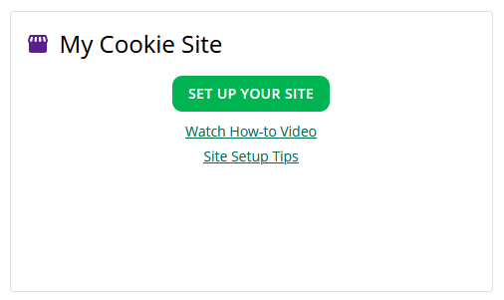
Step 2: Set up Girl Scout’s Site
Have multiple Girl Scouts? Easily switch between each site here.
To set up the Girl Scout’s cookie site:
Click the “Site Setup” link on the menu bar.
Or click the “Set Up Your Site” button from the home page.
Notes:
Script:
To setup the Girl Scout’s cookie site, click on the “Site Setup” link in the Menu bar at the top. There will also be a Set Up Your Site button on the Home page in the My Cookie Site section.

Slide 39
Four sections to set up the site
Girl Scout Site Set Up
Goal Setting: Set My Sales Target
My Cookie Story
Photo/Video Upload
Preview and Publish Your Site
Notes:
Script:
There are four sections on the site set up page. The next few slides will cover them in more detail.
1. Goal Setting: “Set My Sales Target”
2. “My Cookie Story”
3. Photo/Video Upload
4. Preview and Publish Your Site

Slide 40
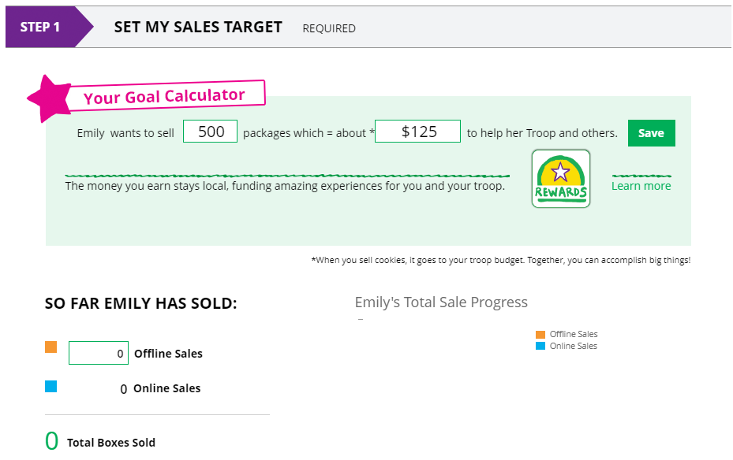
Goal Setting: Set My Sales Target
Step 2-Setup Your Site
2
1
3
4
Notes:
Script:
In the Goal Setting: Set My Sales Target section
Girl Scouts will enter how many packages of cookies they are working to sell this year through online and offline sales.
When the information is entered, the calculator will show how much money the troop will get from the hard work.
Clicking on “Rewards” will take the Girl Scout to the rewards page to see what rewards the Girl Scout might want to work towards. If the council is not using the function, there will be a link to the rewards flyer.
Girl Scouts can enter any offline packages they have sold so their customers will see their total sales, not just their digital sales.

Slide 41
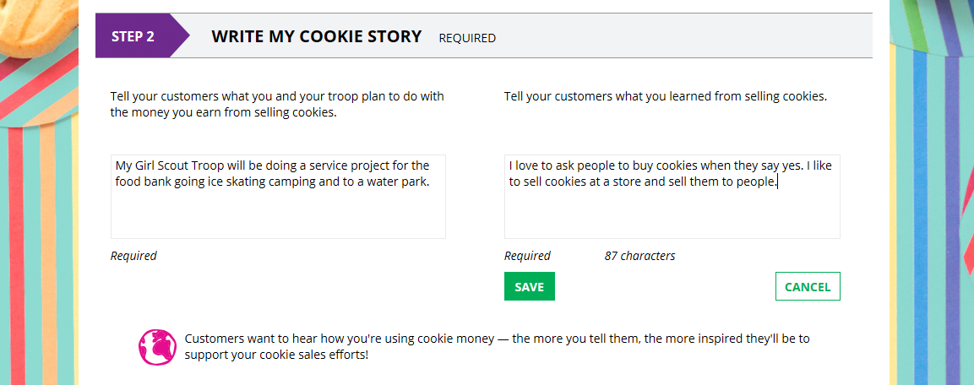
My Cookie Story
1
2
3
Notes:
Script:
My Cookie Story section.
Girl Scouts tell their customers about a troop goal and why it’s important.
Girl Scouts share what they’ve learned from the cookie program.
Save their story. They can make edits to it at any time.

Slide 42
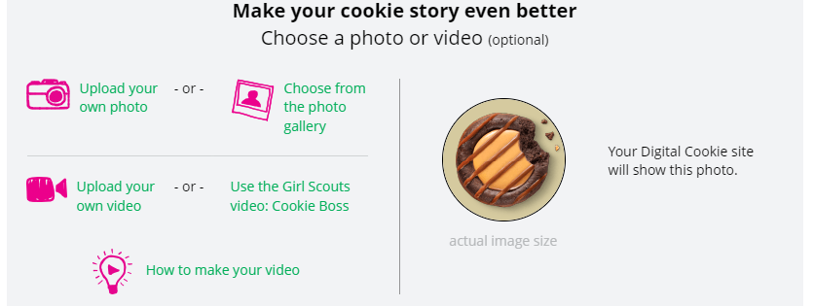
Photo/Video Upload
Girl Scouts who uploaded a photo or video of themselves sold more than double the boxes on average than those who did not.
1
2
3
Notes:
Script:
Photo/Video Upload section
1. Girl Scouts can choose to upload a photo or use a picture from the gallery.
2. Or, Girl Scouts can upload a video or use a GSUSA video (note the “Cookie Boss” video is changing, once Girl Scouts are in the site they will have a new video to select)
3. Bonus! Girl Scouts can get tips on how to make a great video.

Slide 43
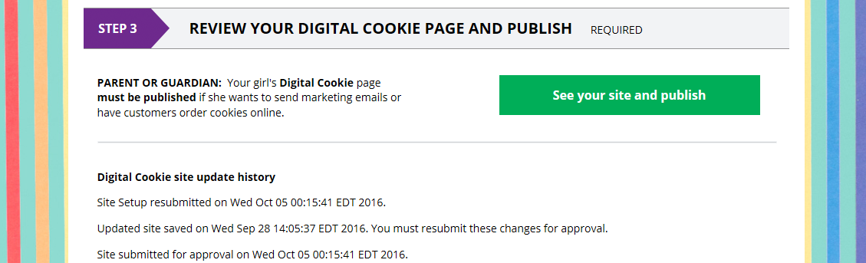
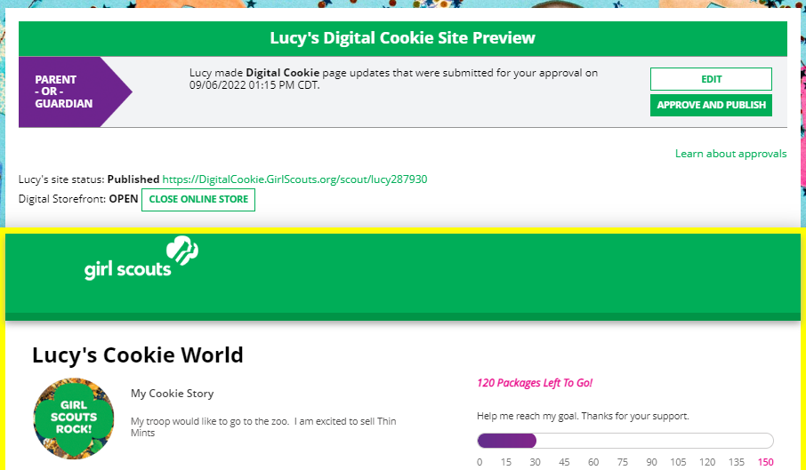
Approve and Publish
Step 2-Setup Your Site
If your button only says “see your site” you may be missing some required fields or didn’t make any changes. Go back and check that everything has been completed.
Click to edit
Click to review and publish
Notes:
Script:
Once the Girl Scout has entered all the site details, they will click the See your Site and Publish button. They will see what the customer will see.
There are a few things you should check prior to publishing the site:
Is the spelling and grammar correct and does it tell a story?
Make sure the photo or video are displaying correctly.
Are the goals accurate?
If you need to change anything, click Edit and make changes
If it looks good, approve and publish the site.
Girl Scout’s 13+ will have a button that says, “see your site and submit for approval”. They can see the preview and edit. Parent is sent an email to approve the site.

Slide 44
Digital Cookie Pages

Slide 45
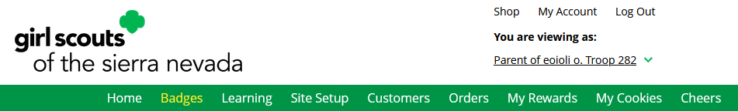
Badges

Slide 46
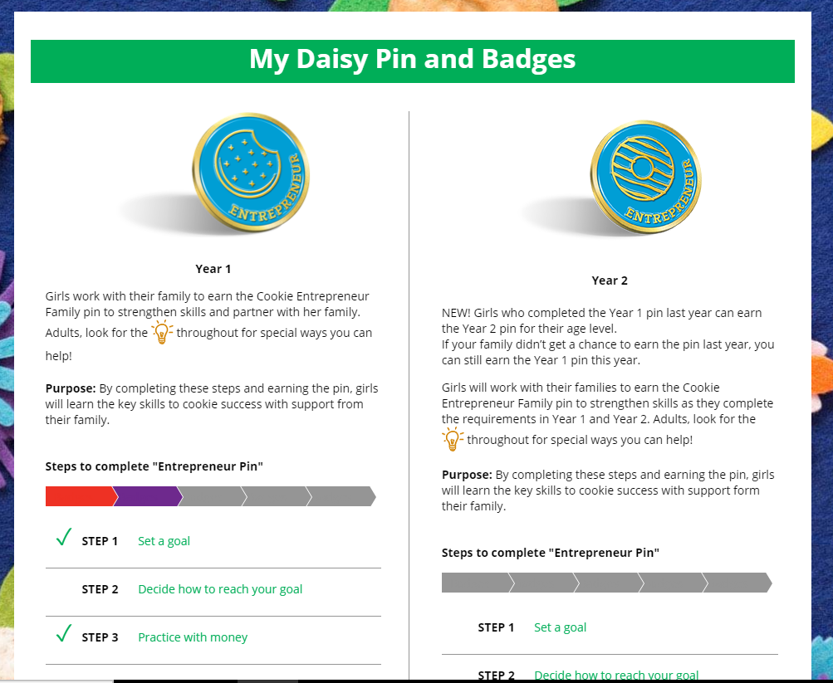
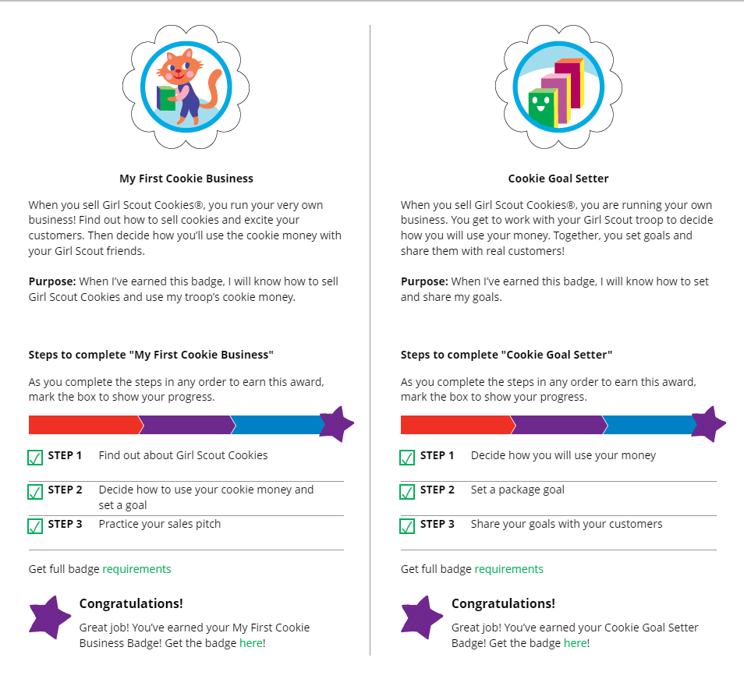
Badges
Notes:
Script
The Badges page displays the Cookie Entrepreneur Family Pins, and the Cookie Business badges appropriate to your Girl Scout’s level.
For the badges, Girl Scouts can read an overview of the steps. For full details, check with the troop volunteer or purchase the online requirements using the shop link or from your local council store.
For the Cookie Entrepreneur Family Pins, Girl Scouts can click on the instructions for each step.
The instructions for each step of the pin will pop up. Girl Scout can click on the link to complete any activities in Digital Cookie, and once completed the Girl Scout will click the box next to each step to mark as complete.
When the box for the last step in earning that pin is checked, a pop-up will appear asking to confirm the Girl Scout completed the last step. Once confirmed, she can’t go back.
Girl Scouts can mark the steps as completed even if they finished the badge earlier.
If they wants to do the steps again, Girl Scouts can—they are all great tools for their cookie sale. When all steps are completed, a star will appear at the end of the progress bar, and Girl Scouts will get a message of congratulations!
Once the Girl Scout has completed the badge or pin, it will display in color on the home page.

Slide 47
Learning

Slide 48
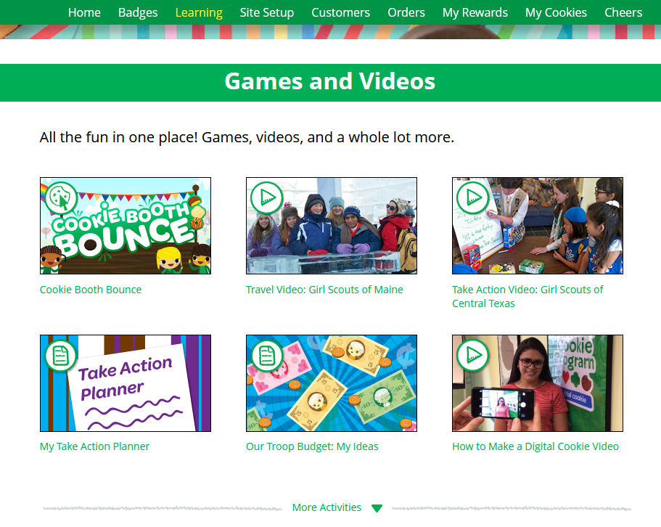
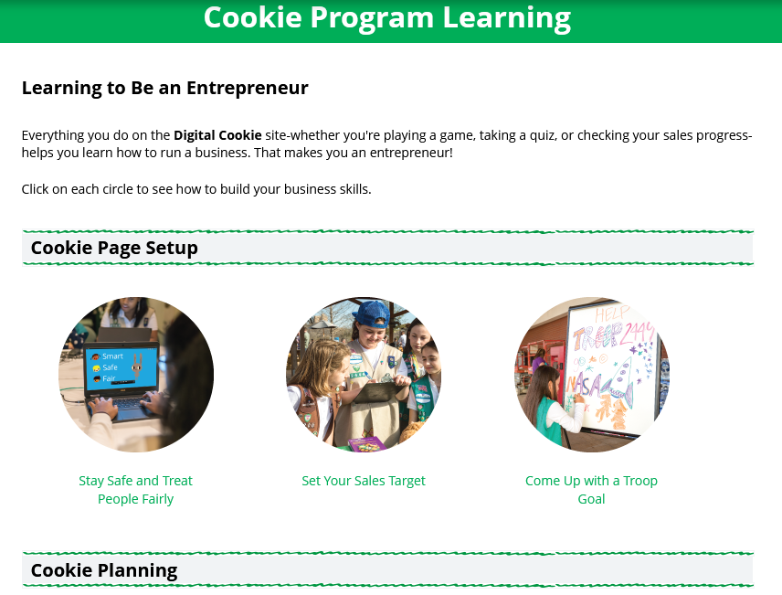
Learning
Notes:
Script
The Learning page has different activities, videos, and printables. The offerings vary by age.

Slide 49
Customers

Slide 50
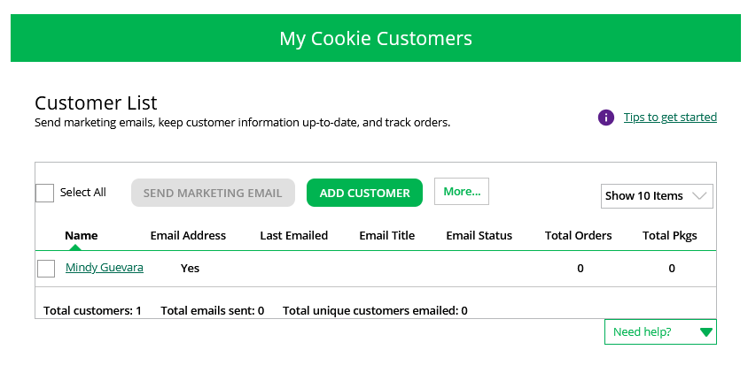
Customers
Add or import customers
Notes:
Script:
The customer’s page is where Girl Scouts can add customer information to their list and send emails.
Girl Scouts can add customer individually by clicking the Add Customer button or import customers under the More button. At the end of the cookie season, don’t forget to export the customer list from the More button also.

Slide 51
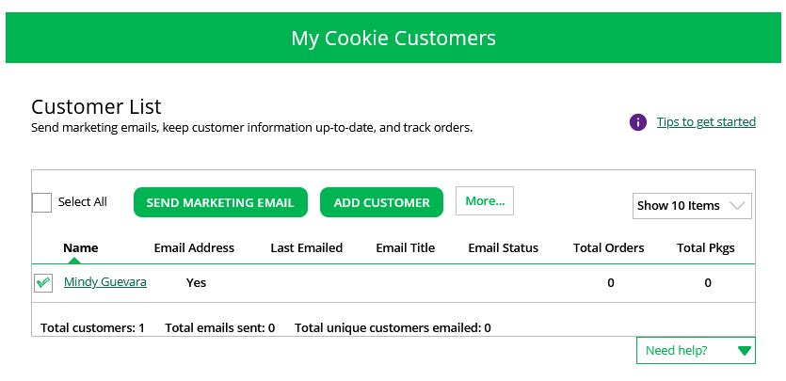
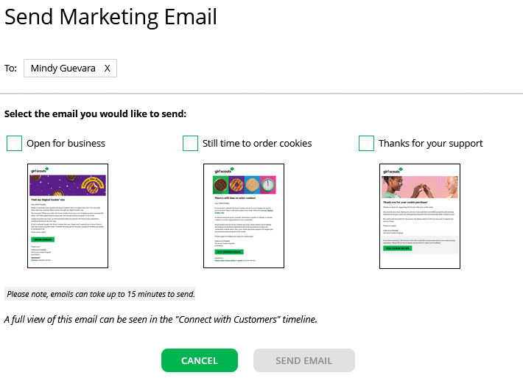
Customers
Then select which marketing email to send.
To Send email, first check box, then click Send Marketing Email Button.
Notes:
Script:
After the customer is added, Girl Scouts can send marketing emails. To send a marketing email first check the box next to the customer’s name or if this is the first time check Select All. Then the Send Marketing Email button will be available. Remember Girl Scouts can only send emails once the council sales have begun. After clicking Send Marketing Email, a pop-up box will appear with three different emails to choose from. Open for Business, Still Time or Order Cookies, and Thanks for Your Support. If you do not see Open For Business, that is because your council has a shipping promotions going on and the shipping promotion email has taken its place. If you do not want to offer the shipping promotion email, use the Still time to order cookies email.

Slide 52
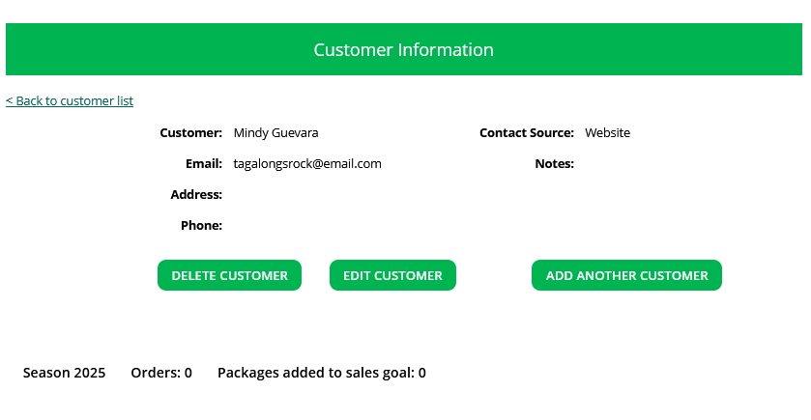
Customers
Viewing Customer Information
Notes:
Script:
Girl Scouts can also view and edit their customer’s information from the customer page by clicking on the customer's name. From here they can delete, edit, or add another customer. They can also see if the customer placed an order.

Slide 53
Orders

Slide 54
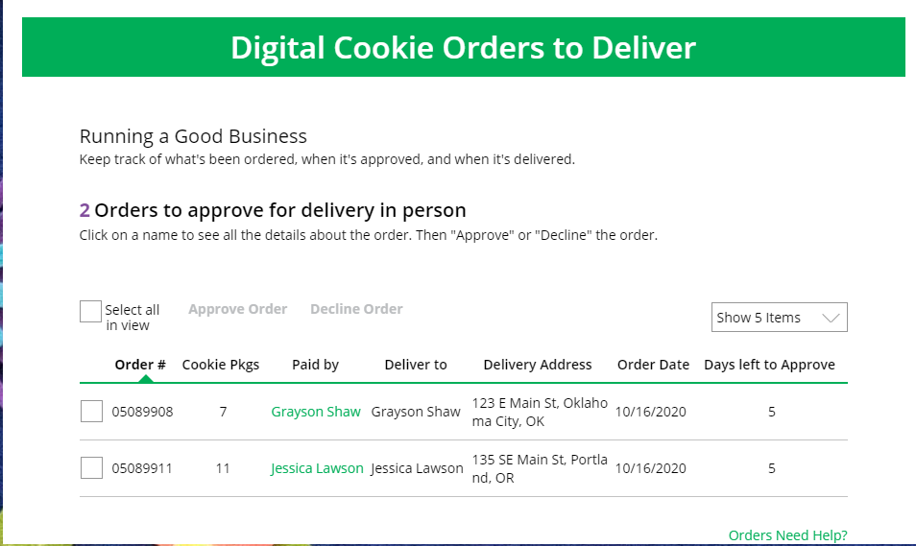
Orders
Click on the “Paid by” name to review customer and order details
When determining whether to approve or decline the order, consider:
Is the customer a known and trusted individual?
Are you willing and able to get the cookies to the customer’s location before the end of the sale.
AND
Do you have or will you have the inventory available?
If so, “Approve Order.”
Notes:
Script:
The top of the orders page is a list of any In-person delivery orders that need to be approved.
In this section you will see a brief overview of the order.
Orders must be approved or declined with in 5 days, or the order will be automatically declined and revert to the customer’s second option of cancel or donate. The order cannot be changed, and the customer will have to place another order.
::Read slide on determining whether to approve order::
If you are unable or unwilling to fulfill the customer’s order, click “Decline Order” and the order will default to whatever second option the customer has selected: “Cancel” or “Donate”.
If an order has not been approved by midnight, you will receive an email from email@email.girlscouts.org with the subject “Action required: you have an in-person delivery request!”.

Slide 55


Orders
Approving/Declining Orders in Bulk
Check box
Once you approve or decline you can’t change the action and an email is deployed to the customer.
Notes:
Script:
There are multiple ways to approve and decline orders for delivery. The first way is to approve orders in bulk. You can do that by checking the boxes in front of the orders you want to approve or decline and then click “Approve Order” or “Decline Order”
A pop-up message will appear asking you to confirm the action you have selected.

Slide 56


Orders
Once approved: customers receive an email to expect their cookies within two weeks of when you have them.
Approving/Declining Orders Individually
Notes:
Script:
The second way to approve orders is individually:
Click on the customer's name to bring up the order details and click “Decline Order” or “Approve Order” at the bottom.
If you decline the order, you will get a pop-up message confirming you want to decline the order and understand if the order is being cancelled or donated.

Slide 57

Orders
Orders to Deliver
Orders must be marked as delivered to update cookie inventory correctly.
Select all
OR
Select a customer
Notes:
Script:
After approving an order, the order will pop down to the next section “Orders to Deliver”. Once the order has been delivered, log back into Digital Cookie and mark those orders delivered.
There are two ways to indicate you have delivered your order:
Check the “Select All” box to select all of the orders on the page; they will all be marked “Order Delivered”.
Check the box in front of any orders you have delivered, and then click “Order Delivered.”
When they are marked as delivered, they will move down into the third section on the page as a completed order.

Slide 58

Completed Orders
Orders
Customers not added to the customers list will not roll over to the following year.
.
Notes:
Script:
In the completed orders section, Girl Scouts can see all orders including shipped and donated orders.
If the customer is not in her Digital Cookie contact list, your Girl Scout can check the box in front of the customer’s name and click “Add to Customers tab.” Then, the customer will be in her records for sending thank-you emails this year and marketing emails next year for repeat business.

Slide 59
My Rewards

Slide 60


My Rewards
Purple star =Goal
Earned Reward
As Girl Scouts earns a reward, they will see a message on their “My Rewards” tab letting them know they earned another reward.
Select Size
Notes:
Script:
Girl Scouts can see the rewards they can earn for selling cookie packages, they can get more details about each reward and select which ones they choose when they unlock a new reward level through sales.
Girl Scouts can also see where their cookie goal is in relation to the rewards!
Girl Scouts can see all the rewards they can earn by clicking on the down arrow on the right side. It may still be locked, which means the Girl Scout hasn’t yet sold enough packages to earn the reward, but they can still see the reward(s) and get more details by clicking on them.
The data for what rewards the Girl Scout has earned comes from the number of cookies the troop cookie volunteer has in their records for the Girl Scout. Check with the troop cookie volunteer if you believe the information is incorrect.
Not all rewards are represented here. System can’t accommodate Gift of Caring rewards, Per Girl Average (PGA) rewards, etc.
Girl Scout selections do not feed directly to the baker system. Troop cookie volunteer will need to pull the report from Digital Cookie but having Girl Scouts select choices and sizes in Digital Cookie cuts down on the amount of work the volunteer does at the end of the sale.

Slide 61
My Cookies

Slide 62

My Cookies-Inventory: Offline Sales Entry
The total number of packages that have been allocated to your Girl Scout from the troop cookie volunteer.
Offline sales need to be updated by the Girl Scout/caregiver when the Girl Scout delivers cookies not ordered/paid for through Digital Cookie.
1
2
Notes:
Script:
Digital Cookie can help you make sure that you have enough cookies for your orders, track your progress on delivering/selling offline orders AND/OR make sure that your records of cookies received agrees with what your troop cookie volunteer has given your Girl Scout.
The top part of your My Cookies page shows the total number of packages that have been allocated to your Girl Scout from the troop cookie volunteer. It could include booth sales or troop sales. It is not the same as the number of cookies you are personally responsible for.
The inventory section gives you a quick view of how many cookies you should still have undelivered and how many you may need to fill your in-person orders.
“My Offline Sales” This is something that needs to be updated by the Girl Scout/her caregiver when she delivers cookies and receives a cash or check payment for them. If they are not entered in this section, they will not be removed from her inventory and this section will not be correct.
To enter offline sales, click the down arrow by the number of packages on the left side and open a screen to enter those sales. When those are entered, click “Save Updates”
Once you click Save Updates, you will be asked to confirm you want to update the inventory.
ABC Councils: note the cookies will be in order card order once the Girl Scouts are in the system.

Slide 63

My Cookies-Inventory by Variety cont.
Current Inventory
Pending Delivery/To Approve
Inventory Needed
1
2
3
Notes:
Script:
There are three other sections that calculate your inventory. The first is “Current Inventory”. Clicking the arrow next to the total number of packages will show you this information by variety.
If you click the arrow next to any of the varieties, you will see more detail on how that number was calculated.
The “Received” numbers come from the information the Troop Cookie Volunteer has of how many cookies you have received and signed for. If you believe there is an error in this, please contact your Troop Cookie Volunteer.
The “Delivered” section will reflect the Offline Sales the Girl Scout has entered above, any sales the Girl Scout made on her Mobile app using the “Give Cookies to Customer Now” feature and any girl delivery orders that have been delivered and marked delivered to her customer on the orders tab.
The next section will show how many cookies you need to fill girl delivery orders you have approved and girl delivery orders that you have yet to approve. Expanding each variety will show you how many orders are approved and how many are needing to be approved with how much inventory you need for each of those categories.
The final inventory section is Inventory Needed. This will show if you need any packages of cookies to fill your orders. Expanding any of the sections that show a number will show you how many you need and why. If you see a number for a variety in this column, be sure you can get the cookies you need before approving an order for a customer.
If you have questions about any of the numbers of received orders listed in your Current Inventory, ask your Troop Cookie Volunteer for more information.
Remember, it may take the volunteer a few days to enter transactions, so be patient if you have received cookies from the troop that need to be entered.

Slide 64

My Cookies Tab-Financials
See how much money is owed for cookies and how that has been calculated.
Notes:
Script:
The Financials section is a valuable tool to help you understand the amount due for the cookie sale and how the troop is calculating the amount.
Using the “at a glance” view is a great way to see the overall amounts paid and due. If you need more detail, you can expand any of the sections to find out more.
There are four sections to your financials that you can expand to get details.
Initial Cookies (Order Card)
This section may not apply if the council does not do initial order.
If you expand this section with the arrow, you will find information on the initial packages you received at pickup, minus any packages you received for in-person delivery orders because those were pre-paid and you do not owe for those.
You will also see any Council or Troop Charity (Cookie Share or Gift of Caring) packages that you had orders for.
NOTE: Cookie and Specialty packages may apply if your council sells cookies at two different pricing tiers. Contact your troop cookie volunteer for additional information.
Additional Cookies Received
The categories are the same as the Initial Cookies but reflect packages transferred to you from the troop. For any questions about this or if this figure does not reflect the packages you picked up, please contact your troop volunteer.
Payments
Online Paid: This reflects any online payments you received for In-Person Delivery or Cookies in Hand orders
Offline Paid: This amount is any payments for cookies received offline, generally cash or check, that you have given to your troop volunteer that they has entered.
If this does not match your records, contact the troop cookie volunteer to help understand the differences.
Total Balance Due
Total Money Owed: The amount you owed for the cookies received at initial pickup and additional cookies received. Note, if your council sells cookies at two different prices, that has been accounted for in your money owed.
Total Money Paid: The total from the “Payments” section.
Total Balance Due: The difference between the amount owed and the amount paid.
If you think any of the figures in this section are incorrect, contact your troop cookie volunteer to compare the information she has on file for you from what you think this should be.

Slide 65

My Cookies Tab-Delivery Settings
Notes:
Script:
The Delivery Settings function gives you the opportunity to turn off Girl Scout delivery and off varieties of cookies. This might be useful if you run out of a cookie variety and can’t get any more to fill customer orders or you are entirely out of cookies for delivering to customers or otherwise are unable to deliver cookies to customers.
If you are worried about your inventory, always check with your troop cookie volunteer first to see if you can get more cookies before turning off a variety. Turning it off means a customer doesn’t have the option to purchase it for delivery so you don’t have to decline their order and disappoint them if they can’t get the variety they ordered.
When you know you need to turn off delivery or a variety(ies), go to the bottom of your “My Cookies” tab and find the Girl Scout Delivery Settings section.
When you select “inactive” to turn off the Girl Scout delivery option for your customer, you will get a warning message. If you want to turn delivery off, click “Update delivery settings”. Once you have turned it to inactive, the varieties section will be removed and is superseded by a message. You can turn the site back on at anytime during your council sale dates.
If you wish to offer delivery but are out of a cookie variety and can’t get more inventory, you can turn off just that variety of cookie for delivery and customers can only purchase those for shipping and not delivery. To do that, simply click the “off” button then click the Update delivery settings button, and it will remove that variety from the Girl Scout delivery option. If you are able to offer that to customers again, return to this section and click the “on” slider to turn that variety back on.

Slide 66
Cheers

Slide 67


Girl Scouts can only send to other girls in their troop but can receive Cheers from customers and leaders, and other girls in their troop.
Cheers
To send a Cheer, Girl Scouts can click Pick a cheer to send next to the Girl Scout they want to cheer.
Notes:
Script:
Girl Scouts can be even more excited about their Digital Cookie experience when they give a Cheer to another Girl Scout in their troop or receive one from a troop member, troop volunteer, or even a customer.
In the Cheers module, Girl Scouts can see the other members of their troop and the percentage of sales towards them reaching their goal.
They can select the “Pick a cheer to send” drop down next to the name of the Girl Scout they wish to cheer.
Girl Scouts will see a choice of .gif images and short messages they can send. As they select the message and image they will see a preview of the cheer and then can click “Send this Cheer”
When Girl Scouts have cheers that have been sent to them, they can see how many cheers on their dashboard and from there, they can click to view their cheers.
If the cheer is from another Girl Scout in their troop they can “Cheer Back”, which will take them to a quick screen to return the cheer.
If they do not see “Cheer Back” as an option, the cheer is from a troop volunteer or customer, and they can’t send a cheer back to those supporters.
Note: some of the Cheers pictures will be different once Girl Scouts are in the system.

Slide 68
Digital Cookie Registration Self-help Steps

Slide 69






Digital Cookie Registration Self-help Steps
Need Help to Log In
Notes:
Script:
If you did not receive your Digital Cookie registration email, there are a few steps you can try before reaching out to customer support for help.
Click on the “Need Help to Log In” link on the Digital Cookie home page. Digitalcookie.girlscouts.org
The Help With Log In page will appear. From here you can:
Request a registration email.
Check the email address that’s on file for you.
Reset your password.
Contact Customer Support.

Slide 70
Digital Cookie Help Center

Slide 71


Digital Cookie Help Center
Your go-to place if you need support!
Notes:
Script:
There are many places in Digital Cookie to receive support. There are FAQs, Tip Sheets, Videos, and links to contact customer support.
Click Need help to log in:
If you didn’t receive your registration email and you want to check which email address is on file.
Forgot your password
Click Help at the bottom of the page to go to the Help Center for FAQs, Tip Sheets, and more.
There are also help sections built into the site.

Slide 72


Digital Cookie Help Center
Select which role and category you need support on.
Inside, each category will have detailed instructions, links to tip sheets, or even video tutorials to help you.
Notes:
Script:
In the Digital Cookie Help page you can select the role you need support on and then select the category
Inside each category there are detailed instructions, links to tip sheets, or video tutorials to help the user.

Slide 73

Digital Cookie Help Center
After looking, still can’t find what you need? Contact customer support.
Click the topic you need help with and complete the form for more assistance.
Or click the Live Chat button to chat with a Digital Cookie support agent during business hours.
Notes:
Script:
Still need help? Click on the Contact customer support link
Click the topic you need help with and complete the form for more assistance
Want to talk to a live agent? Click on the Live Chat button during business hours to chat with a Digital Cookie customer support agent.

