Slide 1
Mobile App
Notes:
Script:
The next slides will cover using the Mobile App for volunteers

Slide 2
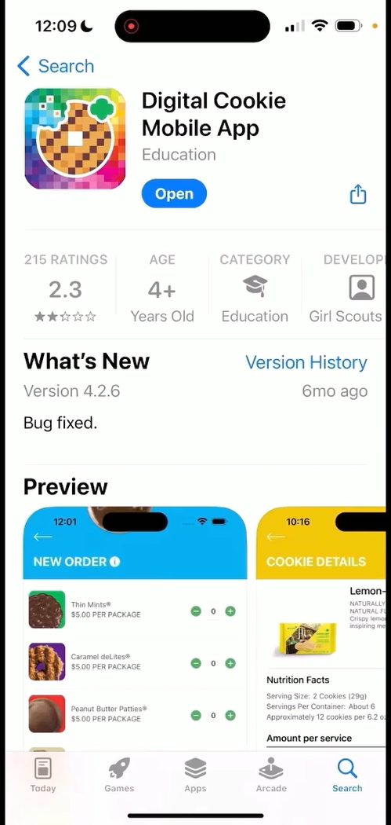
Digital Cookie Mobile App
Download a new version of the mobile app each year.
Mobile app found in iTunes or Google Play store.
Notes:
Script
Troop volunteers can use the Digital Cookie Mobile App to help Girl Scouts process and review orders placed through the troop’s digital site. Make sure to download a new version of the mobile app each year.

Slide 3
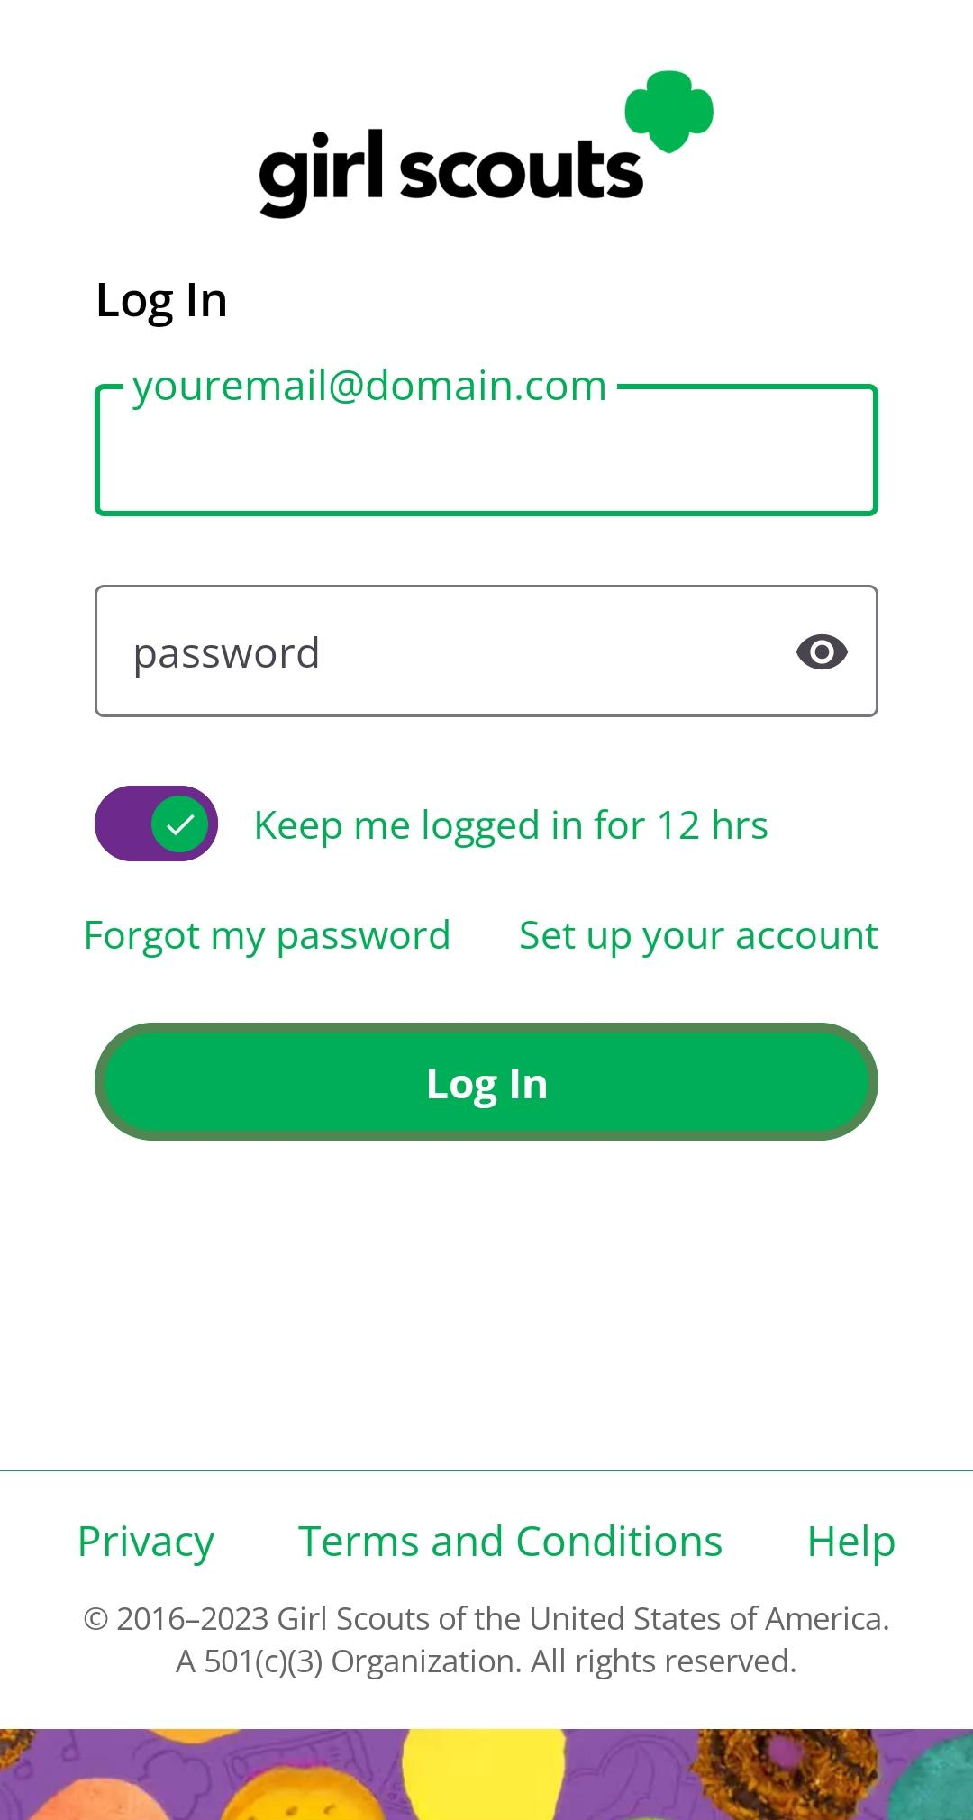
Use the same email and password use for Digital Cookie
Troop site must be published
All volunteers with Digital Cookie access can use the mobile app
Logging In
Notes:
Script
To log into mobile app, you will use the same email and password used to log into the Digital Cookie browser site. The troop site must be published in order to access the mobile app for the troop role. All volunteers with access to Digtial Cookie will be able to log into the Digital Cookie mobile app.

Slide 4
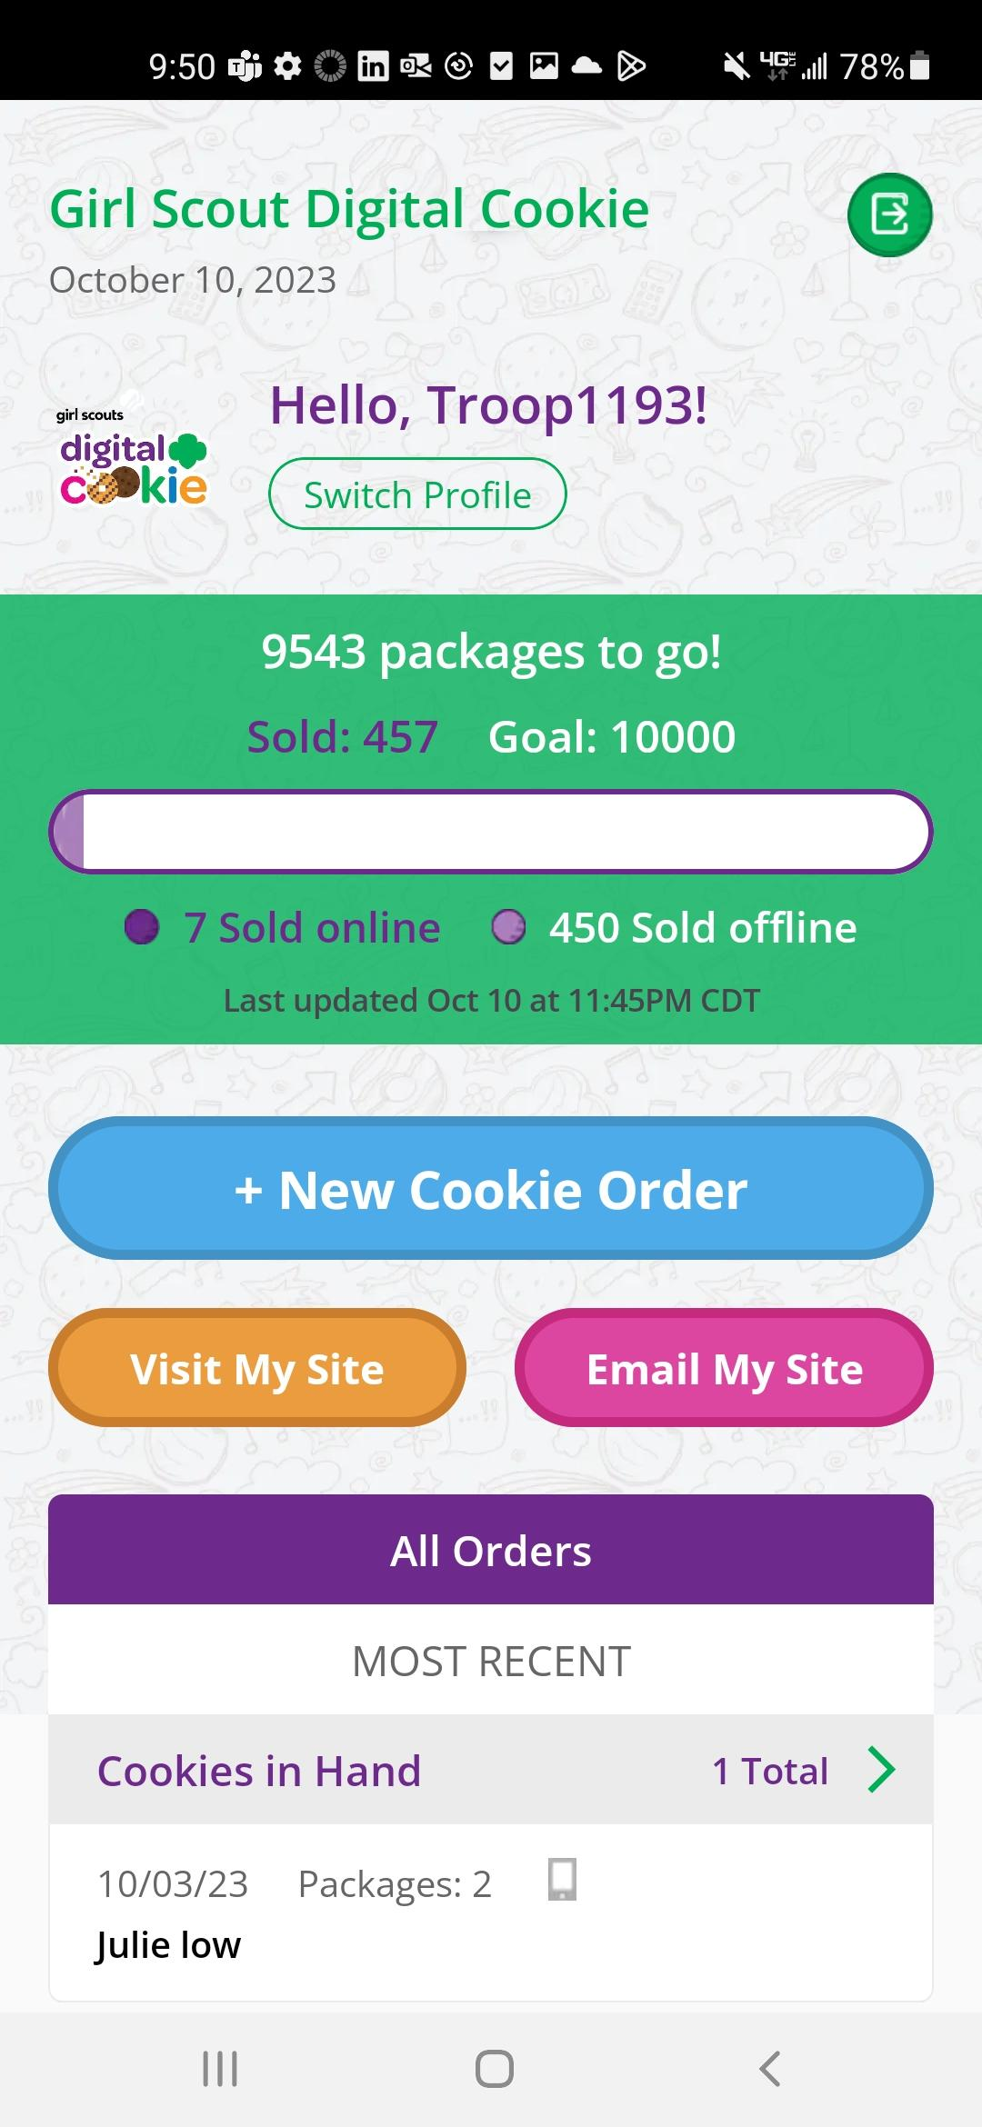
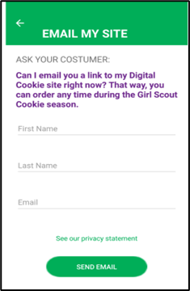
Digital Cookie Home Screen
Visit My Site
Customers can scan the QR code to visit the Troop’s Cookie Site.
Email My Site
Select Troop Role
Girl Scout’s can send a marketing email to a customer.
Notes:
Script
When you first log into Digital Cookie, you will want to select your troop role to see the main screen. From here you can place a new cookie order, share the site with customers, or view all orders.
The “Visit My Site” button will take the Girl Scout to a QR code, the Girl Scout can then turn the phone around allow the customer to scan the QR code to make a purchase from the Troop’s Cookie Site.
The “Email My Site” button is used to send a marketing email to customers who can then purchase from the Troop’s Cookie Site at a later time.
To take an order using the mobile app, Girl Scouts will click the “New Cookie Order” button.

Slide 5
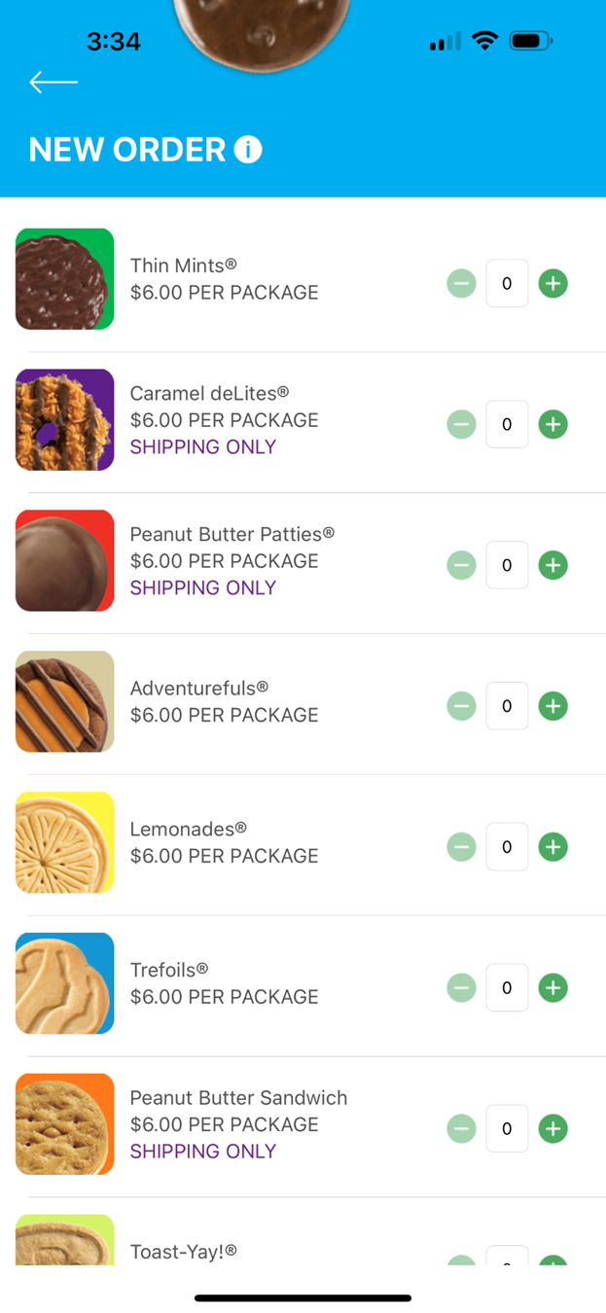
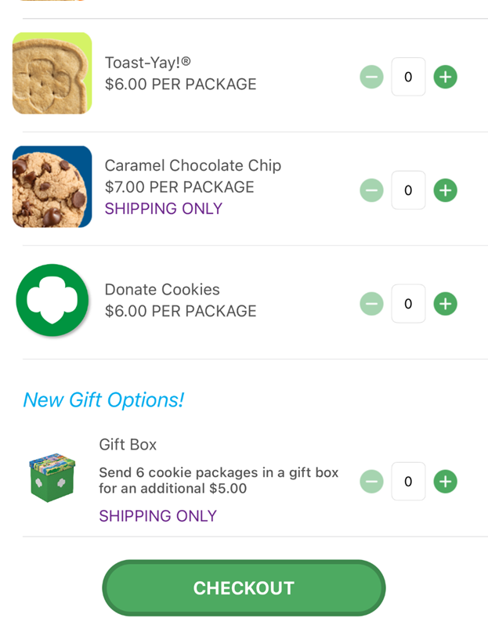
New Cookie Order
Step 1: Select Cookie Varieties
Notes:
Script:
First the Girl Scout will enter the varieties the customer would like to purchase by using the plus and minus signs next to each cookie variety. Then select Checkout.

Slide 6
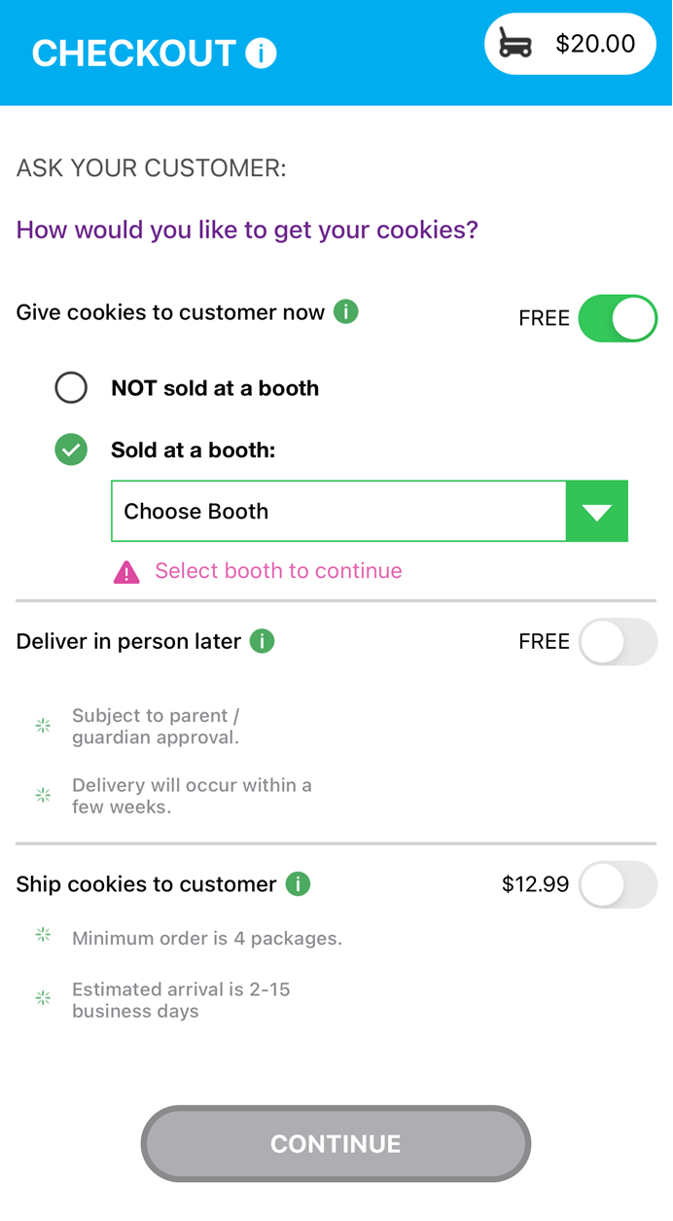
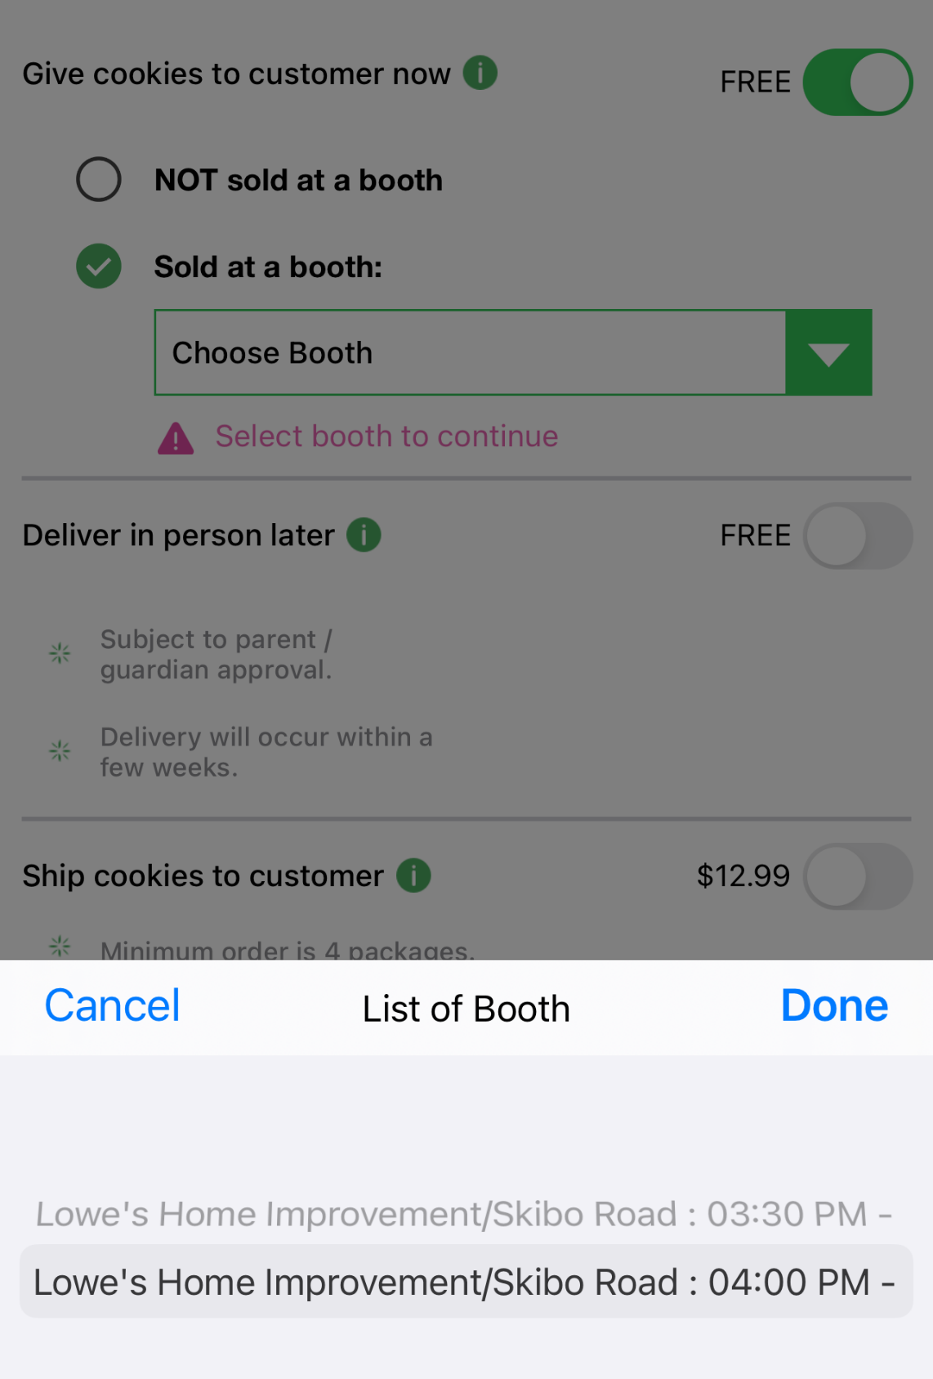
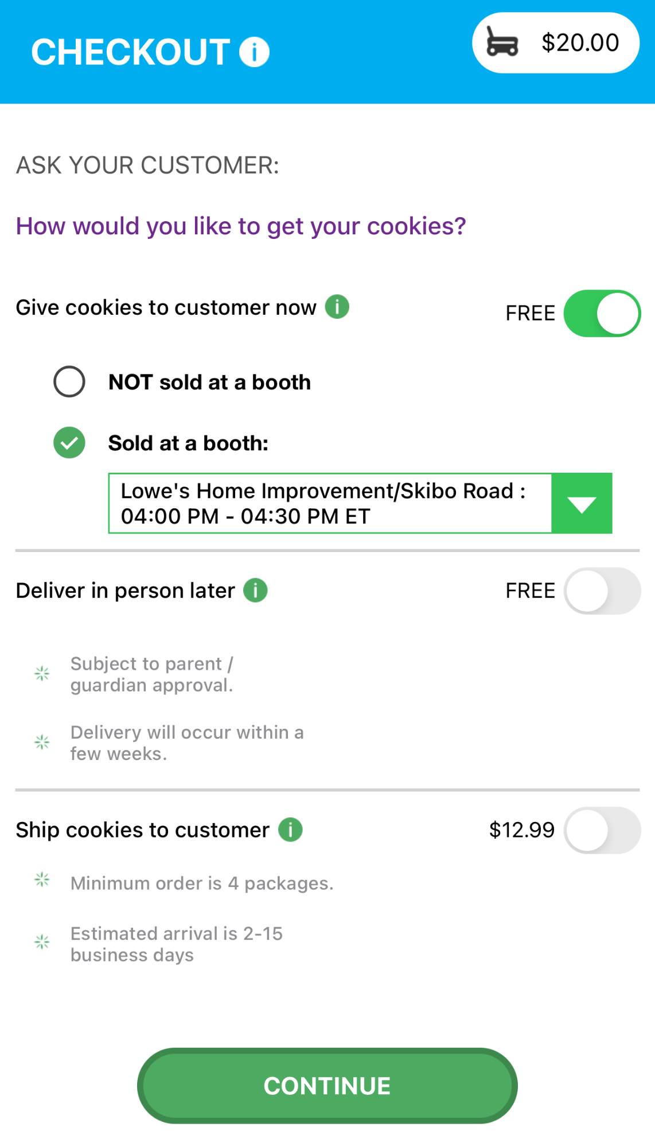
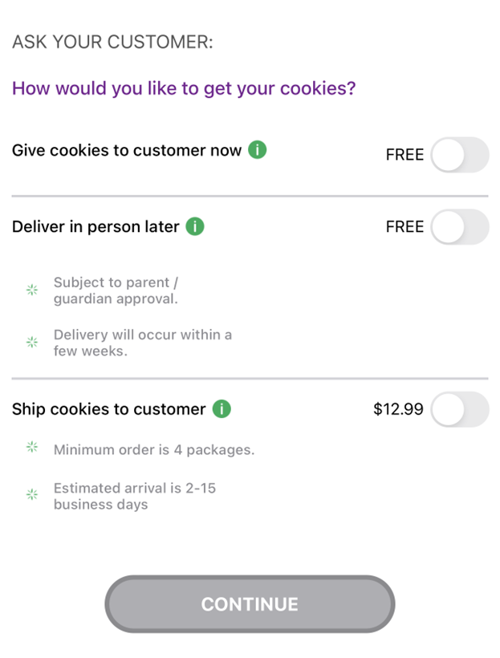
New Cookie Order
Step 2: Select how the customer would like to receive their cookies.
Notes:
Script:
Next the Girl Scout will determine how the customer will receive their cookies. If using the troop app, the most likely way is “Give cookies to customer’s now”. The other options are available but are less likely to be used through the mobile app. Once the “Give cookies to customer now” option is select, the Girl Scout can now choose if she is at a booth or not. When the at a booth is select, the Girl Scout will be able to select which booth the troop is at. Then click continue.

Slide 7
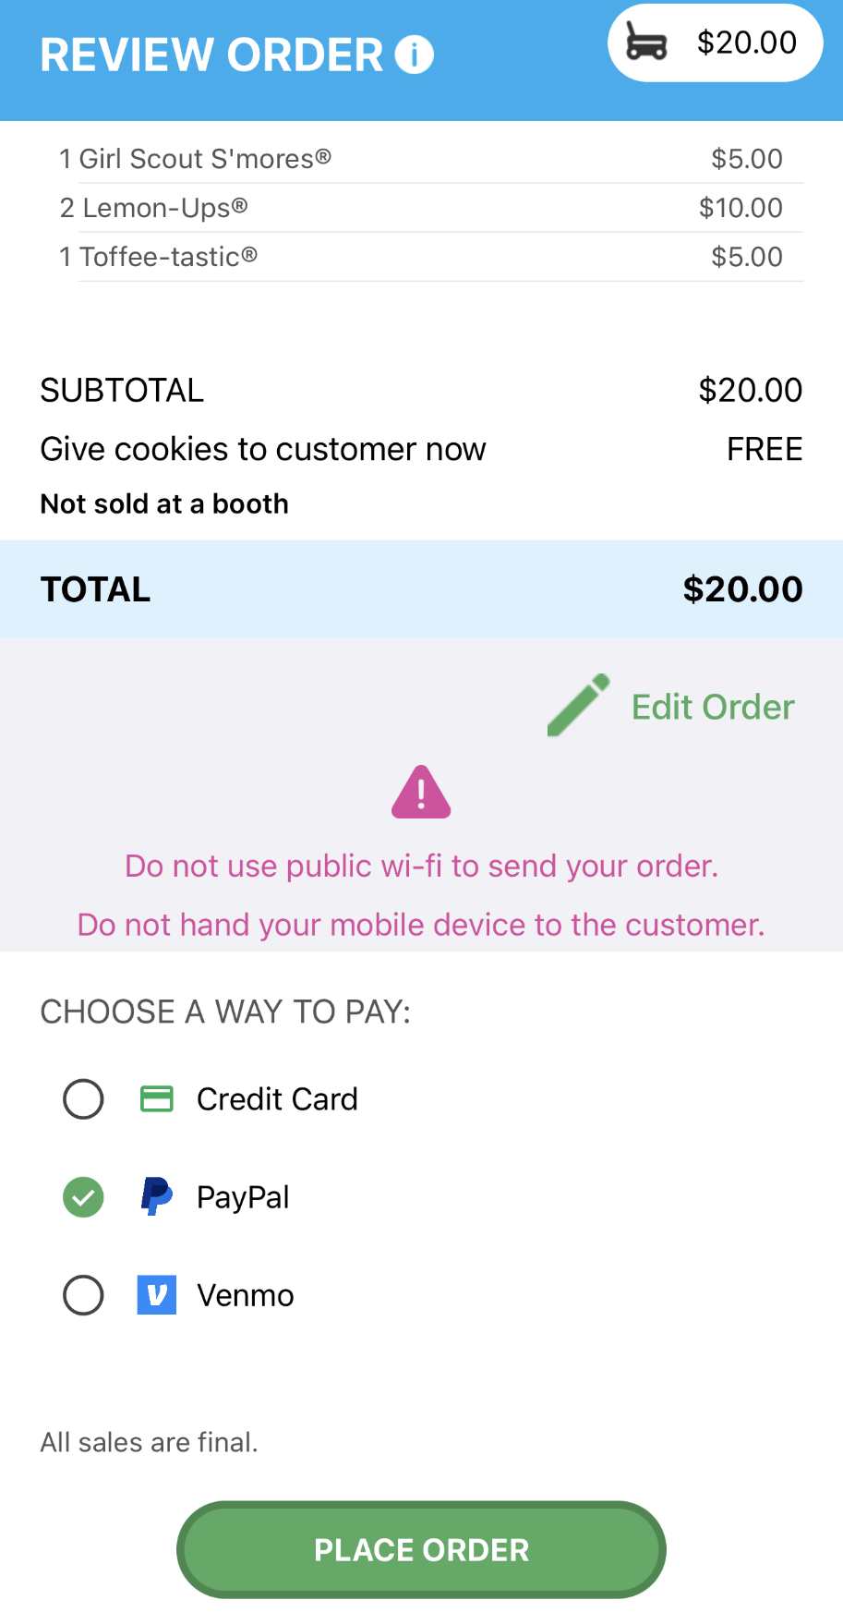
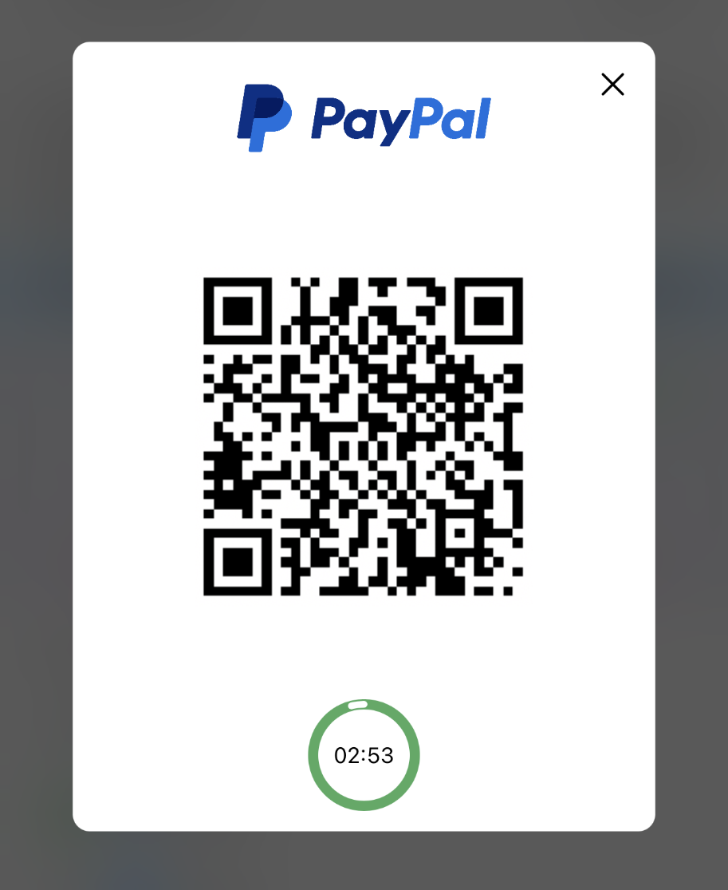
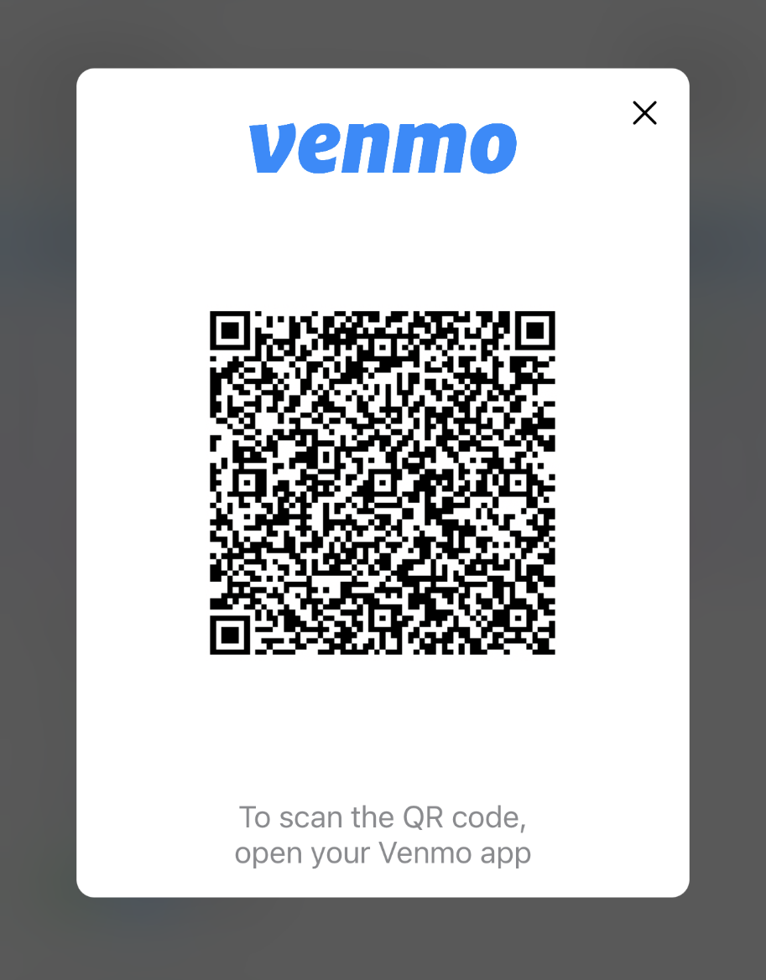
New Cookie Order
Only available for Cookies In-hand orders
Step 3: Select how the customer would like to pay
Demo
Demo
Notes:
Script:
Next the Girl Scout will ask the customer how they would like to pay for their order. The customer can choose Credit Card, PayPal or Venmo. The PayPal/Venmo options are only available through the mobile app when the Give Cookies to Customer Now option has been selected. If the customer choose PayPal or Venmo and the Girl Scout has selected that option and clicked Place Order. A QR Code will appear, the Girl Scout can turn the phone around and the customer can scan the QR code with their phone to pay with their PayPal/Venmo account. (To the customer side volunteers can view the mobile app video)

Slide 8
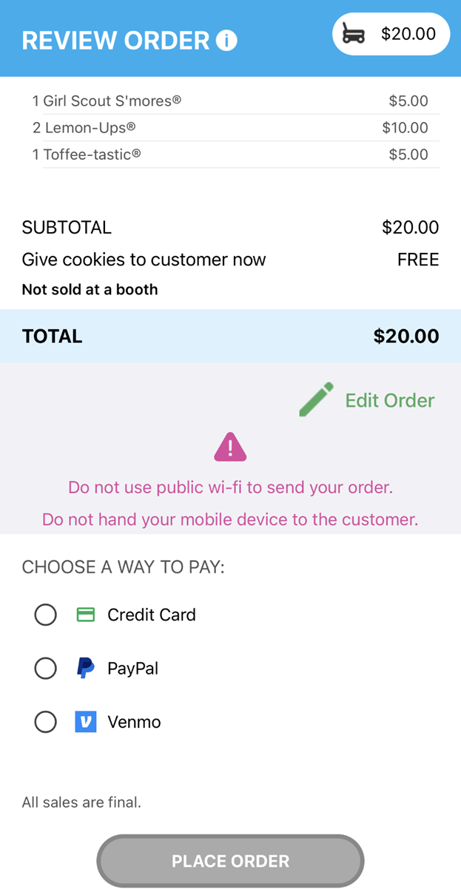
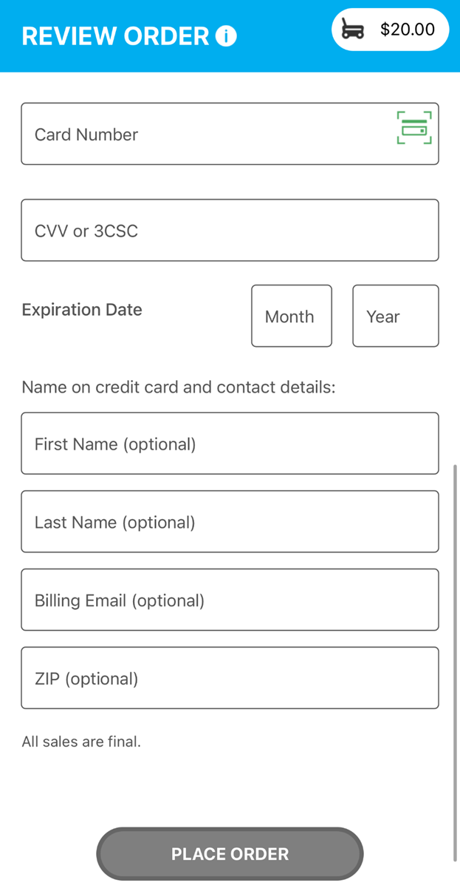
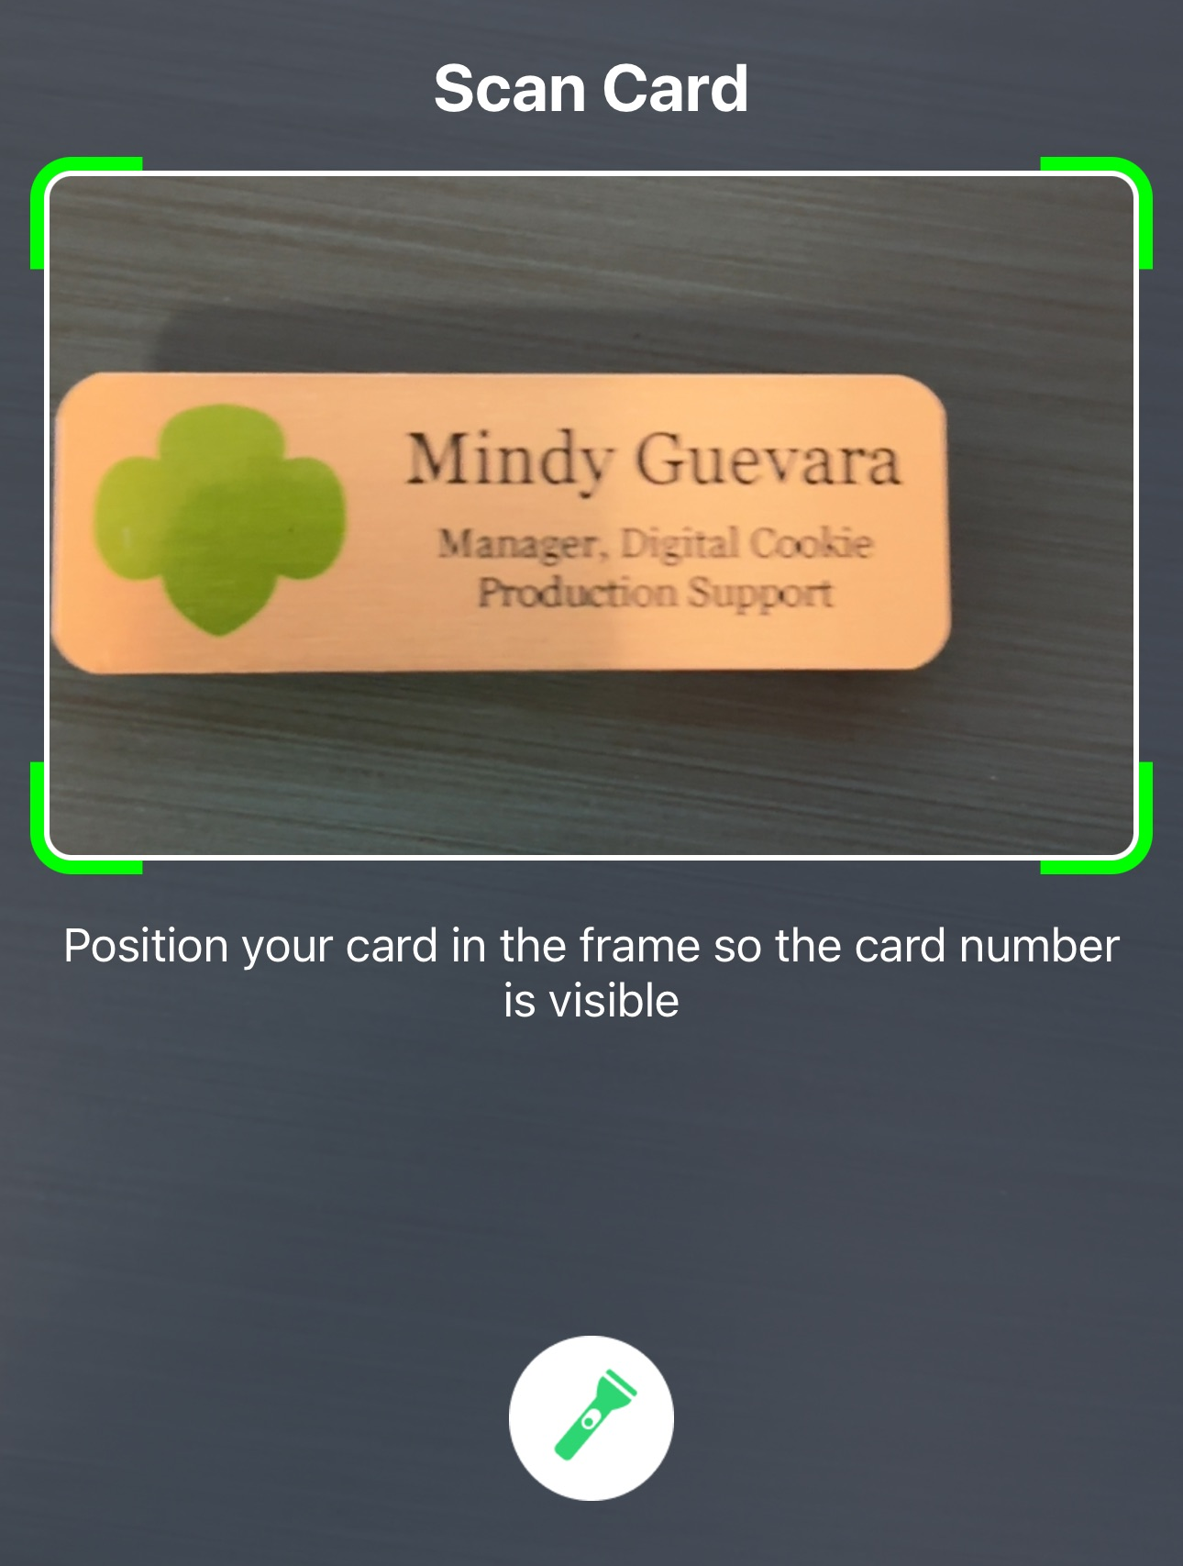
New Cookie Order
Contact details are now optional. Girl Scouts should still ask if the customer would like an email confirmation.
Step 3: Select how the customer would like to pay
Use the Scan Card feature instead of typing all the numbers.
Tip: Have good lighting and double-check the numbers before placing the order.
Notes:
Script:
If the customer choose to pay by Credit Card, the Girl Scout will scroll down on the phone to enter the payment details. Use the Scan Card feature instead of typing all the numbers. Make sure to have good lighting when using this feature. One the payment details have been entered, the Girl Scout can ask the customer if they would like to receive an email confirmation. While the customer details are optional now it is always good to ask and handy to have in case of any issues with the order.

Slide 9
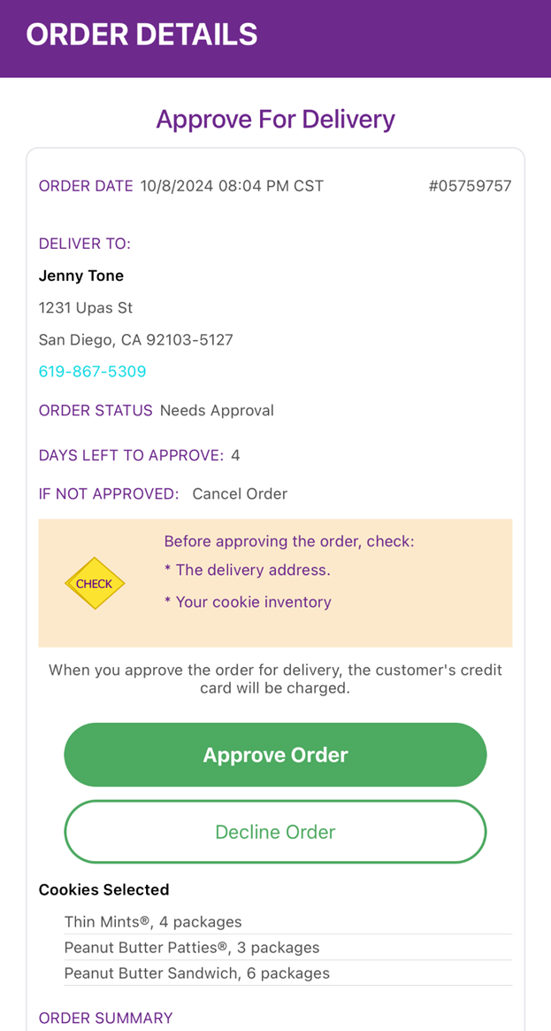
All users have access to approve orders through the mobile app
All Orders
Notes:
Script:
From the home screen, users can view all the orders place through the troop’s cookie site as well as through the mobile app by scrolling down to the all-orders section. To view the orders in a specific category, click on the green arrow to the right to bring up all the orders. Then click on the order you want to view. If the order is an in-person deliver order users can approve or decline the order from the app. Leaders should have a conversation with parents regarding the process of approving orders placed on the troop site, since all users will be able to approve these orders.

